Slide 1
Plan Member Education Session
APEX
Version August 1, 2023

Slide 2
Today’s topics
Public Service Pension Plan
Benefit calculation & options
Deductions
Indexing
Survivor Benefits
Group insurance benefits
Leave without pay
Service buyback
Retirement process
Resources
2

Slide 3
The public service pension plan
The public service pension plan is a “defined benefit” plan which provides a predictable, steady stream of retirement income for your lifetime.
The defined benefit formula uses your highest average salary & pensionable service.
Other benefits include:
Survivor benefits: provides an income for eligible spouse and children in the event of member’s death.
Disability benefits: immediate unreduced monthly pension regardless of age when approved of permanent disability.
Annual indexing: provides protection from inflation.
Portability: possible eligibility to transfer pension credits when joining or leaving the public service.
3

Slide 4
Benefit Calculation
2% per year to a maximum of 35 years (lifetime pension and bridge benefit)
Average of 5 highest consecutive years of pensionable salary - includes performance pay
Early retirement - 5% reduction for every year prior to eligibility of an unreduced pension
4

Slide 5
Immediate Annuity (Unreduced Pension)
GR 1 (plan member before January 1, 2013):
55 or older + 30 or more yrs of service, or
60 or older + 2 or more yrs of service
GR 2 (plan member on or after January 1, 2013):
60 or older + 30 or more yrs of service, or
65 or older + 2 or more yrs of service)
Medical retirement: Any age with 2 or more years of pensionable service and permanently disabled as certified by Health Canada
5

Slide 6
calculation unreduced pension - Gr 1
2% (lifetime + bridge) | X | Pensionable Service (years and days) | X | Highest Average Salary* (5 best consecutive years) | /12 = | Monthly Pension
2% | X | 35 yrs service/ age 55 | X | $150,131 | /12 = | $8,757
2% | X | 30 yrs service/ age 55 | X | $150,131 | /12 = | $7,506
*Highest Average Salary includes performance pay.
NOTE: Periods of part-time employment will affect the calculation.
6

Slide 7
Calculation for an unreduced pension - Gr 1
1.375% | X | Years of pensionable service | X | Average salary up to the AMPE* | /12 = | Monthly Pension
1.375% | X | 35 | X | $61,840 | /12 = | $2,480
Plus
2% | X | Years of pensionable service | X | Average salary in excess of the AMPE* | /12 = | Monthly Pension
2% | X | 35 | X | $88 291 | /12 = | $5,150
Lifetime Pension (pension after 65)
$7,630
0.625% | X | Years of pensionable service | X | Average salary up to the AMPE* | /12 = | Monthly Pension
0.625% | X | 35 | X | $61,840 | /12 = | $1,127
*AMPE → Average Maximum Pensionable Earnings
Bridge Benefit
$1,127
Lifetime + Bridge (pension before 65)
$8,757
7

Slide 8
Bridge benefit & Regular CPP/QPP
This benefit “Bridges” your pension until you reach age 65 or CPP/QPP Disability
Lifetime Pension
Payable for Life
Bridge (to age 65)
Regular CPP/QPP
Age 65
8

Slide 9
Pension Benefit Adjustments
Processed as a result of a pay rate change
ex.: an EX who retired after April 1, 2022 will have their pension amount revised once new rates of pay are approved (includes any retroactive performance pay)
Adjustments are retroactive to the date of pension eligibility
Pension prior to adjustment:
Best 5 year average $150,131
2% x 30 x $150,131 /12 = $7,506
Pension after adjustment:
Best 5 year average $158,000
2% x 30 x $158,000 /12 = $7,900
Gross increase of $394 a month
9
Notes:
Current Max EX-01 142,982 – last update expired March 31, 2022

Slide 10
Early retirement options
10

Slide 11
Lump Sum Options
Age | Pensionable Service | Lump Sum Payment
Any | Less than 2 years | Return of Contributions
Younger than 50 (55 Gr 2) | 2 or more years | Transfer Value
11

Slide 12
Transfer Value Terminates Prior to Age 50 (55 Gr 2)
The TRANSFER VALUE (TV) represents the projected amount you would need to invest today to provide a future benefit similar to the public service pension you earned.
The assumption rates used are based on short & long-term bond yields; not on consumer interest rates (i.e., bank lending rates)
When overall rates increase, the TV decreases. You need a smaller up-front investment to generate your projected pension amount.
Similarly, when rates decrease, the TV increases. You need more up-front to generate the same return over time.
After a TV is paid, all investment risk is your own and you will no longer be entitled to a future monthly pension, survivor benefits, health, dental, regular supplementary death benefit and Post Retirement Life Insurance.
Your option is irrevocable!
12

Slide 13
Transfer Value – Payment options
Amount within tax limit | Amount in excess of tax limit
Transferred to: Locked-in RRSP or Registered Pension Plan and/or Purchase of a life annuity | Paid to: You in cash (and taxed at source) or Your RRSP (if available room) or Combination of both The Retirement Compensation Arrangement portion of the transfer value must be paid directly to you and taxed at source.
13

Slide 14
Annual Allowance (Reduced Pension)
This option is for plan members with at least 2 years of pensionable service, who want to receive a monthly pension
Retirement Age | Pension payable as of:
Younger than 50 (55 Gr 2) | Later of: 50 (55 Gr 2) or date of option
50 (55 Gr 2) or older | Later of: date of termination or date of option
14

Slide 15
Reduction – Gr 1
Pensionable Service | Age | Reduction
Less than 25 yrs or Under age 50 | 50-59 | 5% x (60 - age)
25 or more yrs | 50-54 | Greater of: 5% x (55 - age), or 5% x (30 - service)
 | 55-59 | Lesser of: 5% x (60 - age), or 5% x (30 - service)
NOTE: age & pensionable service are prorated
15

Slide 16
Reduced pension Calculation Gr 1
Scenario | 2% (lifetime + bridge) | X | Pensionable Service (yrs and days) | X | Highest Average Salary | - | Reduction | /12 = | Monthly Pension
Retiring at 50 with 20 yrs service | 2% | X | 20 | X | $150,131 | - | 5% x (60-50) = 50% | /12 = | $2,502
Retiring at 54 with 25 yrs service | 2% | X | 25 | X | $150,131 | - | Greater of: 5% x (55-54) 5% x (30-25) = 25% | /12 = | $4,691
Retiring at 59 with 25 yrs service | 2% | X | 25 | X | $150,131 | - | Lesser of: 5% x (60-59) 5% x (30-25) = 5% | /12 = | $5,942
NOTE: Periods of part-time employment will affect the calculation.
16

Slide 17
Reduction - Gr 2
Pensionable Service | Age | Reduction
Less than 25 yrs or Under age 55 | 55-64 | 5% x (65 - age)
25 or more yrs | 55-59 | Greater of: 5% x (60 - age), or 5% x (30 - service)
 | 60-64 | Lesser of: 5% x (65 - age), or 5% x (30 - service)
NOTE: age & pensionable service are prorated
17

Slide 18
Reduced pension Calculation Gr 2
Scenario | 2% (lifetime + bridge) | X | Pensionable Service (yrs and days) | X | Highest Average Salary | - | Reduction | /12 = | Monthly Pension
Retiring at 55 with 20 yrs service | 2% | X | 20 | X | $150,131 | - | 5% x (65-55) = 50% | /12 = | $2,502
Retiring at 59 with 25 yrs service | 2% | X | 25 | X | $150,131 | - | Greater of: 5% x (60-59) 5% x (30-25) = 25% | /12 = | $4,691
Retiring at 64 with 25 yrs of service | 2% | X | 25 | X | $150,131 | - | Lesser of: 5% x (65-64) 5% x (30-25) = 5% | /12 = | $5,942
NOTE: Periods of part-time employment will affect the calculation.
18

Slide 19
Deferred Annuity (Unreduced Pension)
This option allows you to defer your monthly pension payments until eligible to an unreduced pension at 60 (65 Gr 2)
Ex. Retiring at 52 with 28 yrs of service but choose a Deferred Annuity:
Monthly Pension calculated as follows:
2% x 28 yrs x 5 Year Average Salary = Annual Pension/12
Unreduced pension payable when you turn 60 (65 Gr 2)
Public Service Health Care Plan (min. 6 years pensionable service) and the Pensioner’s Dental Care Plan are available when your pension becomes payable.
19
Notes:
This option is often pursued when other employment occurs immediately after retirement from the government and will continue until age 60 (65 if group 2).
Ex. Retirement at 53 and accept a position outside of the Federal Government (that is not in a Conflict of Interest) and continue to earn salary, at age 60 (65 if group 2), regardless of the other employment relationship, pension becomes payable

Slide 20
Options Summary
Age | Pensionable Service | Option
Any | Less than 2 yrs | Return of Contributions
Less than 50 GR 1 Less than 55 GR 2 | 2 or more yrs | Transfer Value Annual Allowance (reduced) Deferred Annuity
50-59 GR 1 55-64 GR 2 | 2-29 yrs | Annual Allowance (reduced) Deferred Annuity
50-54 GR 1 55-59 GR 2 | 30 or more yrs
55 or older GR 1 60 or older GR 2 | 30 or more yrs | Immediate Annuity
60 or older GR 1 65 or older GR 2 | 2 or more yrs
20

Slide 21
Deductions
Continue
Income tax
Buyback installments
Leave without pay deficiencies
Debts due to the Crown
Optional
Supplementary Death Benefit*
Post-Retirement Life Insurance Plan
Public Service Health Care Plan*
Pensioners’ Dental Services Plan*
Extra income tax at source
Cease
Pension Contributions
Disability Insurance
EI and CPP/QPP
Public Service Management Insurance Plan
*Sales tax applies for residents of ON and QC
21

Slide 22
Indexing
Annual cost-of-living increase
2023 = 6.3%
Applicable January 1st of each year
Accumulated from the first full month following termination. Ex.:
If you retire in May 2023, indexing accumulates from June to December 2023 . The prorated percentage (7/12 x %) would be applied to your pension in January 2024.
If you retire in December 2023, your indexing accumulates from January to December 2024 and full indexing would apply January 2025.
Each year thereafter, the full percentage increase will be added to your monthly pension.
22

Slide 23
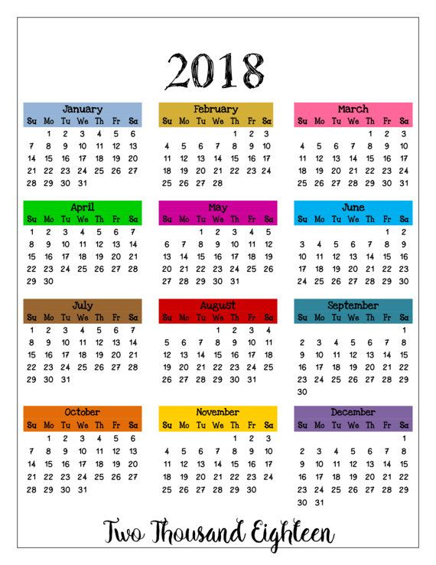
Indexing
2022
Indexing Rate for 2023: 6.3%
Termination May 15, 2022
Pro-rated at 7/12 x 6.3%
First increase January 2023 = 3.675%
Your monthly pension of $7,506 would increase by $275.85 for a total of $7,781.85
23

Slide 24
SURVIVOR BENEFITS

Slide 25
Survivor Benefits Legal Spouse or Common-Law Partner
Legally married before you left the public service = automatic eligibility
Common-law = eligible if:
your cohabitation in a conjugal* relationship started before you left the public service, and
you lived together for at least one year before your death, and
you lived together without interruption until your death.
*A conjugal relationship is one where individuals are financially, socially, emotionally interdependent– where residence, family and related responsibilities are shared, where there is public representation of a committed relationship, etc.
25

Slide 26
Documentation for survivors
Keep your personal information updated with the Pension Centre.
Information we need:
• Proof of marital status (i.e., marriage or divorce certificates)
• Survivor’s contact information
• Copies of birth certificates for your survivor and proof of FT studies for children 18 - 25
Recommendation (common-law relationship):
Set aside records regularly for your partner to demonstrate that your relationship met the established criteria. Ex:
dated letters that were addressed to either or both of you at a common address
Mortgage or rental statements, banking, insurance, real estate, or rental records
medical, prescriptions, or hospital records
bills, receipts, or contracts
records such as drivers license, tax, electoral or census records,
envelopes from cards that were mailed to you, with a visible post-mark
may complete and send in a Statutory Declaration form (PWGSC 2016), which can help document your relationship’s start date.
26

Slide 27
Survivor Benefits
Monthly amount, payable for the life of the survivor
50% of the unreduced pension benefit you would have received before age 65
Relationship existed prior to termination
27

Slide 28
Survivor Separation or Divorce
As long as you remain legally married, that spouse continues to be eligible for a survivor pension even if you are separated.
If divorced, the ex-spouse is not eligible.
A common-law relationship must be continuous from prior to your retirement until your death. If the relationship is/was broken, the common-law spouse is not eligible.
If you have both a legal spouse and an eligible common-law spouse at time of death, the survivor benefit will be apportioned between them accordingly to the length of their respective relationship with you.
28

Slide 29
Optional Survivor Benefit
If you marry after retirement, you may elect to provide your spouse with a benefit by taking a reduction in your own pension.
The reduction would be a fixed percentage of your basic monthly pension including any amount being paid out of the Retirement Compensation Arrangement.
This option must be made within one year of marriage or one year from the commencement of your pension, whichever is later.
Different levels of survivor coverage are available (30%, 40% or 50%).
Your original pension will be re-instated on a go-forward basis, if you divorce or your survivor dies before you.
29

Slide 30
Survivor Benefits Children
In the event of death, children under age 25 may be eligible for a monthly benefit payment. To qualify for a benefit:
child must be under age 18, or
full-time student aged 18 to 25
The allowance per child is 10% of the unreduced pension, to a maximum of 40%.
If you have more than 4 children, the maximum allowance is shared equally between them.
If there is no surviving spouse, the child allowance is 20% of your pension per child, up to an 80% maximum.
30

Slide 31
Survivor Minimum Benefits
If you pass away with no eligible survivors, a lump sum is paid to your Supplementary Death Benefit beneficiary.
If you’ve not named a beneficiary, the payment is sent to your estate.
This payment is considered taxable income
Lump sum is the greater of:
Return of Contributions plus interest
or
Five years of unreduced pension
Less
Any pension amounts already paid
31

Slide 32
Group Insurance Benefits
There is more to your pension than just a monthly payment!

Slide 33
Supplementary Death Benefit (SDB) (*Similar of term life insurance)
Annual pensionable salary x 2 (rounded up)
ex: Salary = $142,982 | SDB = $286,00
Age | Coverage | Monthly premiums
15¢/month per $1,000
Under 65 | $286,000 | $42.90
$10,000 free at 65
65 | $286,000 | $41.40
Reduces by 10% per year starting at 66
66 | $257,400 | $37.11
67 | $228,800 | $32.82
74 | $28,600 | $2.79
Up to paid up amount
75 and up | $10,000 | $0.00
*Continues if eligible to pension within 30 days of termination
33

Slide 34
SDB - Naming a Beneficiary
You can designate | If no designation…
Estate | Estate
One person 18 or older
Charity/religious/ educational institution
Not taxable as income
You can designate or amend a beneficiary anytime by completing the Naming or Substitution of a Beneficiary (PWGSC 2196)
It is important to keep your beneficiary’s contact information updated with the Pension Centre.
34

Slide 35
Public Service Management Insurance Plan
Basic Life Insurance
Supplementary Life Insurance
Accidental Death & Dismemberment Insurance
Dependents’ Insurance and AD & D Insurance
Contact PSMIP at 1-819-420-6229
Conversion privilege
Must be done within 31 days of termination of employment
Contact Industrial Alliance at 1-800-977-2117
35

Slide 36
Post-Retirement life Insurance Plan (Members of the executive group who retire with an immediate continuing pension)
Annual pensionable salary
(adjusted to final salary at retirement)
ex: Salary = $142,982 | PRLIP = $143,00
Year | Coverage | Monthly premiums
1 | $143,000 | free
Reduces by 25% after year 1
2 | $107,250 | free
3 | $71,500 | free
4 | $35,750 | free
Payable to your designated beneficiary(ies)
for life | $35,750 | free
Premiums paid by former employer and will be considered a taxable benefit
36

Slide 37
Public Service Health Care Plan
Available if you have 6 or more years of pensionable service
Family coverage – spouse/common-law and children up to 21 (25 if full-time student)
Monthly Premiums eff. July 1, 2023 | Level 1 | Level 2 | Level 3
Individual | $64.44 | $72.84 | $87.66
Family | $134.72 | $146.86 | $164.09
Provides Daily Hospital Coverage | $90.00 | $170.00 | $250.00
37

Slide 38
Pensioners’ Dental Services Plan
Family coverage – spouse/common-law and children up to 21 (25 if full-time student)
Must keep it for 3 full calendar years
Once cancelled, cannot reapply
Coverage | Monthly Premiums eff. Oct. 1st, 2017
Individual | $17.46
Family (Self + 1) | $36.85
Family (Self + 2 or more) | $44.38
38

Slide 39
Leave Without Pay

Slide 40
Periods of Leave Without Pay
Authorized pensionable leave
Repayment Options (lump sum or payments over 2x the period of leave)
First 3 months is pensionable
Option not to count periods of leave greater than 3 months
Income Tax Act Limits: 5 years plus 3 years
40

Slide 41
Service Buyback

Slide 42
Service Buyback
$
Cost is based on type of service and timing
Increases pensionable service used to calculate your pension
Ω
Repayment can continue into retirement
Buyback: Public Service, RCMP, Canadian Forces and outside service
☼
Medical Exam may be required
42

Slide 43
Retirement Process

Slide 44
When you are ready, or begin contemplating retirement
3 – 6 months before your planned retirement date, call the Pension Centre.
A Pension Client Experience Advisor sends you a package outlining your options.
Send proof of your resignation approval to the Pension Centre.
Complete and return required forms before retirement so we can issue your first pension payment within 45 days.
Enjoy retirement!
44

Slide 45
Resources

Slide 46
Resources
Pension and benefits website
www.Canada.ca/pension-benefits
Video series – You and Your Pension Plan
https://www.tpsgc-pwgsc.gc.ca/remuneration-compensation/services-pension-services/pension/video/index-eng.html
Forms
https://www.canada.ca/en/treasury-board-secretariat/services/pension-plan/plan-information/forms.html
46

Slide 47
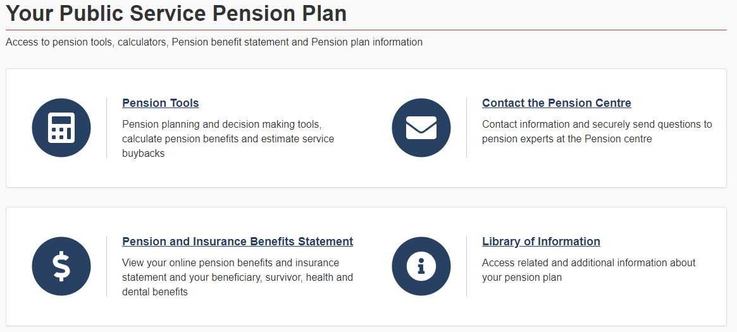
Pension Portal via Compensation Web Application (CWA)
Access your pension plan information, pension benefits calculator, and tools to estimate service buyback and survivor benefits
47

Slide 48
Contact information
Contact | Phone number and website
Service Canada (CPP/OAS) | 1-800-277-9914 www.servicecanada.gc.ca
Québec Pension Plan (QPP) | 1-800-463-5185 www.rrq.gouv.qc.ca
Public Service Health Care Plan & Public Service Dental Care Plan (for employees) | 1-855-415-4414 Access your account (Canada Life)
Public Service Health Care Plan (for pensioners) | 1-855-415-4414 Access your account (Canada Life)
Pensioners’ Dental Services Plan | 1-888-757-7427 Access your account (Sun Life)
National Association of Federal Retirees | 1-855-304-4700 www.federalretirees.ca
Notes:
This contact information is provided for members – it is not meant to be reviewed as part of the presentation. This is a list of some of the most frequently requested contacts outside of the Pension Centre.

Slide 49
The National Association of Federal Retirees has advocated to protect the hard-earned pensions and benefits of retired members of the federal public service, Canadian Armed Forces, RCMP and retired federally appointed judges as well as their partners and survivors since 1963.
We were instrumental in obtaining pension indexation and advocated for the creation of the Pensioners Dental Services Plan (PDSP).
We represent members, and all federal retirees, on the PSHCP Partners Committee at Treasury Board.
Federal Retirees is a not-for-profit membership-based organization incorporated under the Canada Not for Profit Corporations Act.
Join our 170,000 members in 78 branches from coast to coast to coast. You don’t need to be retired to join.
Call 1-855-304-4700 (toll-free) or visit www.federalretirees.ca to become a member.
49

Slide 50
Contact
At the Government of Canada Pension Centre, we’re here to help!
Dedicated line for Executives
1-888-742-1300
50

