Slide 1
This is Day One: Creating Cultures of Leadership

Slide 2
What is your personal leadership philosophy?

Slide 3
What is a personal leadership philosophy?
A set of beliefs and principles you use to evaluate information and respond to people and situations.

Slide 4
Score 110% higher on overall leadership effectiveness
Individuals who can clearly articulate their personal leadership philosophy…
Are rated 140% more effective as leaders by those they lead
Have teams that report higher levels of:
Team Spirit
Organizational Pride
Commitment to the organization
Willingness to work hard
Trust
Score 135% higher on measures of trust
(Kouzes & Posner, 2012)

Slide 5
My Personal Leadership Philosophy
When you don’t know what to do in a situation, ask yourself:
“What would the person I want to be do in this situation?”
Then do that.

Slide 6
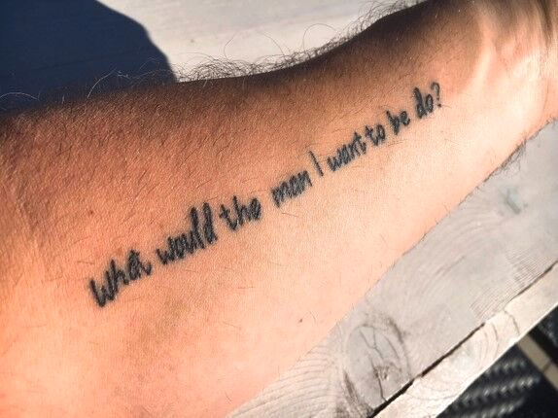
My Personal Leadership Philosophy
When you don’t know what to do in a situation, ask yourself:
“What would the person I want to be do in this situation?” Then do that.

Slide 7
Respect
Integrity
Impact
Honesty
Courage
Accountability
Gratitude
Kindness
Adventure
Friendship
Equality
Passion

Slide 8
Define the things you want to define you.

Slide 9
Why do you matter?

Slide 10
Plan to matter.

Slide 11
Planning to Matter
Three Steps:
Identify Your Values.

Slide 12
PERSONAL VALUE CLARITY AND ORGANIZATIONAL COMMITMENT
Why does it matter?
Employees were asked about
Their level of personal value clarity
Their level of organizational value clarity
Their levels of:
Commitment to the organization
Pride in the organization
Motivation and productivity
Job Satisfaction
(Kouzes & Posner, 2012)

Slide 13
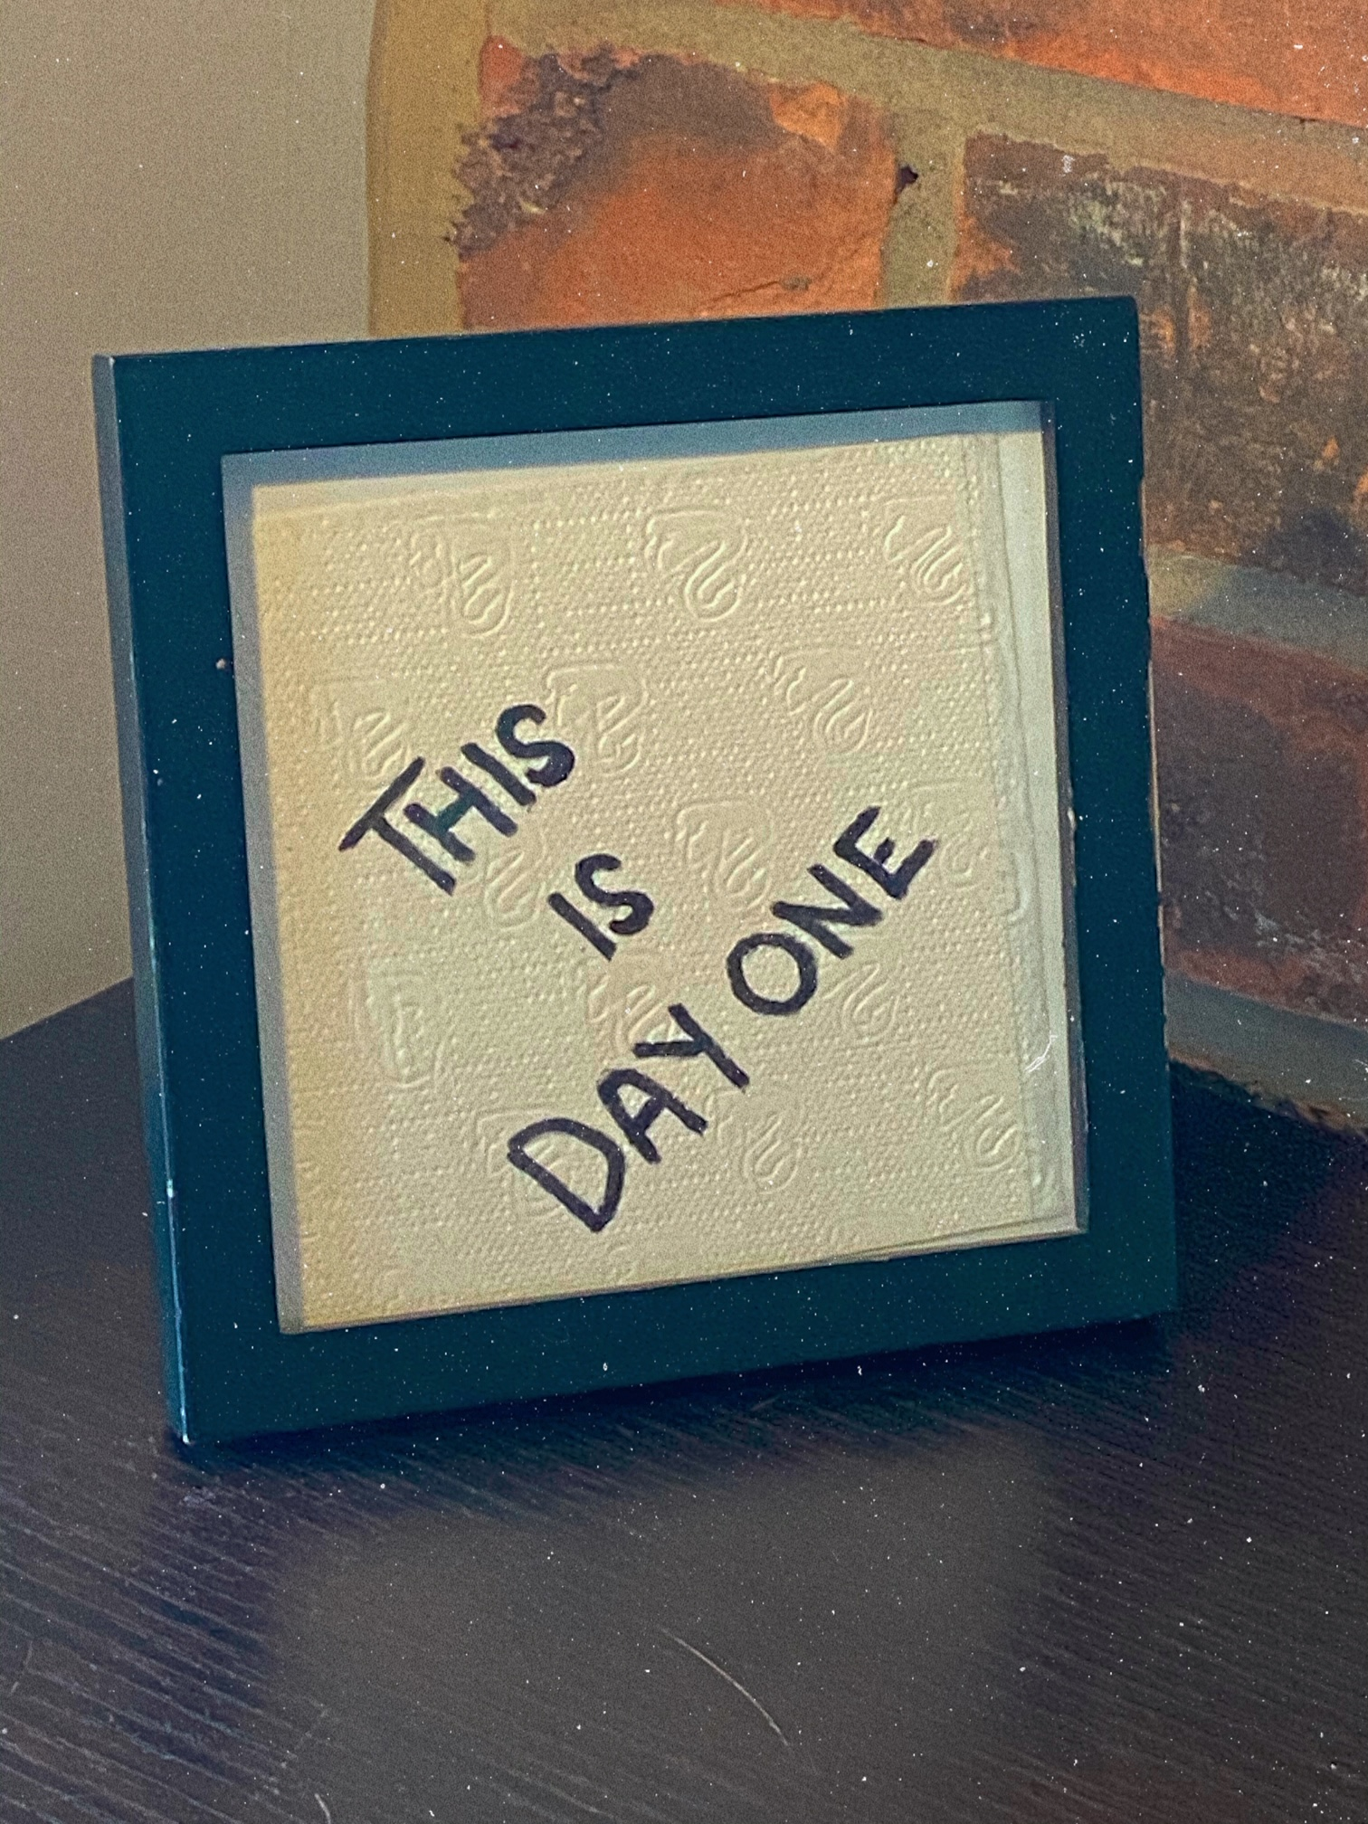
4.87
6.26
High
Clarity of
Organizational Values
Low
4.90
6.12
Low
High
Clarity of Personal Values

Slide 14
Planning to Matter
Three Steps:
Identify Your Values.
Define Your Values.
Create opportunities to live your values each day.

Slide 15
A social experiment.

Slide 16
IMPACT
A commitment to creating moments that cause people to feel as if they are better off for having interacted with you.

Slide 17
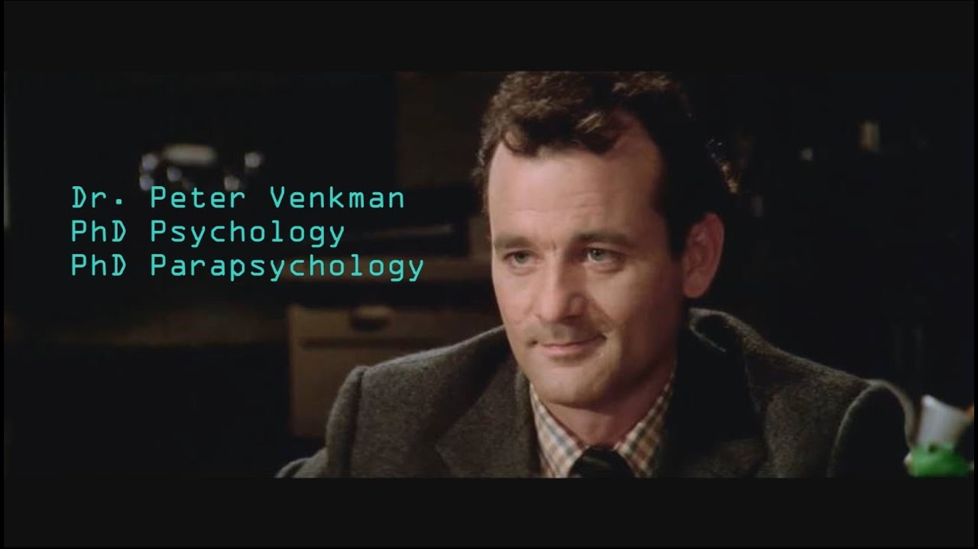
The Zeigarnik Effect
The Question-Behaviour
Effect

Slide 18
The power of the unanswered question…
?

Slide 19
IMPACT
A commitment to creating moments that cause people to feel as if they are better off for having interacted with you.

Slide 20
IMPACT
What have I done today to recognize someone else’s leadership?

Slide 21
THE LEADERSHIP TEST

Slide 22
THE LEADERSHIP TEST
IMPACT
GROWTH
COURAGE
EMPOWERMENT
CLASS
SELF-RESPECT

Slide 23
IMPACT
What have I done today to recognize someone else’s leadership?
GROWTH
What did I do today to make it more likely someone would learn something?
COURAGE
What did I try today that might not work, but I tried it anyway?
EMPOWERMENT
What did I do today to move someone else closer to a goal?
CLASS
When did I “elevate instead of escalate” today?
SELF-RESPECT
What did I do today to be good to myself?

Slide 24
2160

Slide 25
1095

Slide 27
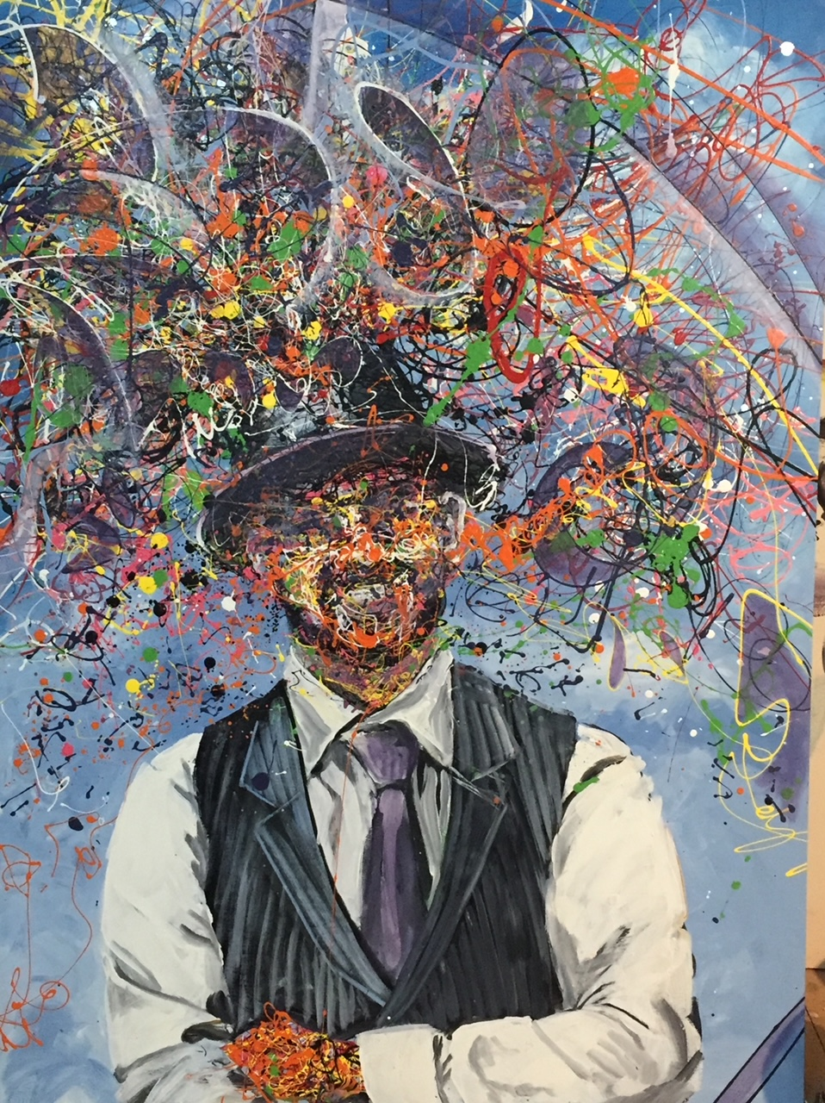

Slide 29
DAY ONE is the day you identify the non-negotiable behaviours that are going to be a part of every day of the rest of your life.

Slide 30
Ordinary acts done with extraordinary consistency change worlds.

Slide 31
Text DAY ONE to 72000
for a copy of these slides and other resources.

Slide 32
drew@drewdudley.com
@DayOneDrew
drewdudley.com
1.855.685.3253

