Slide 1
LEADING WITH
A DYNAMIC MINDSET
DEEPER CLARITY
Nilufer Erdebil
@digitalNil
Notes:
Innovating by Design
Better Thinking by Design

Slide 2
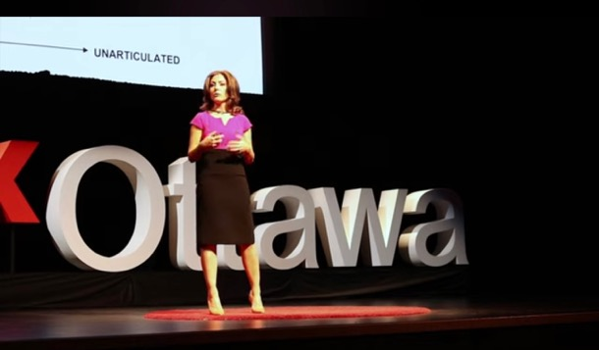
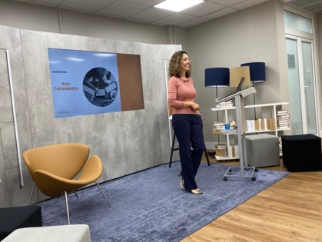

Slide 3
Goal
Mindset is essential to success – personally & professionally
Dynamic mindset is needed for change & transformation

Slide 4
Dynamic leaders take initiative, set ambitious goals, & drive quickly toward them, taking concrete steps to transform ideas into reality.
People with the dynamic mindset have a passion for persuasion. They are good at rallying colleagues to action and influencing change.​

Slide 5
DEEPER CLARITY METHOD
Unlock dynamic mindset to think differently
Team alignment of strategy, methods, tools and mindset
Unbiased collaboration with customers from initiative start to delivery
Progressive action based on new insights, empathy and clarity

Slide 6
What is Deeper Clarity?
Methodology & Mindset for alignment and success
Incorporated principles of design thinking, alignment, strategic foresight and mindset
Clarity to make things lighter
Shifting, adapting & looking for possibilities and opportunities

Slide 7
Results from Deeper Clarity
Organizations hitting targets faster
Teams moving from ambiguity to clarity and alignment
Ie. Teams working together for over 6 months didn’t have clarity on how to solve a highly complex, multi-system, multi-process challenge and within a 3 weeks they had clarity on what they needed to do.
Clarity on new emerging types of clients
Teams more focused and working collaboratively towards the same outcome – client focused
Projects not moving forward because of our process – yes! Projects NOT moving forward

Slide 8
Why Dynamic Mindset?
Personality & behavior of someone changes with the context the person is in.
When we’re in situations we react in habitual & fixed ways rather than observing the dynamics amongst people & responding dynamically.
Teams & leaders focus on preparing for key functional & technical details without paying little attention to the human dimension – adapting to the needs & styles of the people in the room.
HBR: Leading in the Flow of Work (Jan 2024)

Slide 9
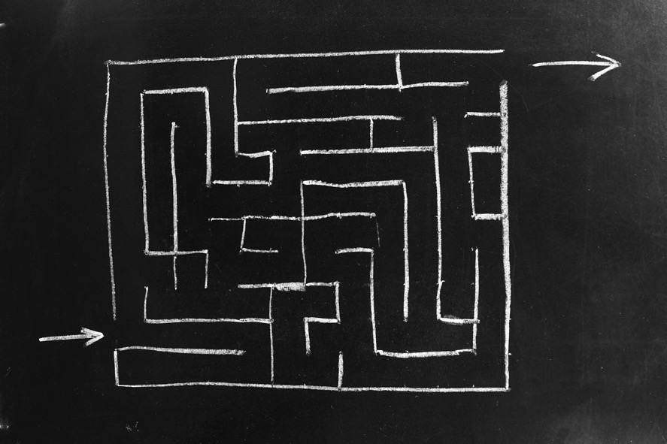
THE GUT ASSUMPTION TRAP
Not enough clarity or alignment
Overwhelmed by information
Not taking time to understand customers
Using only past experiences and gut feeling to design new products, services and processes

Slide 10
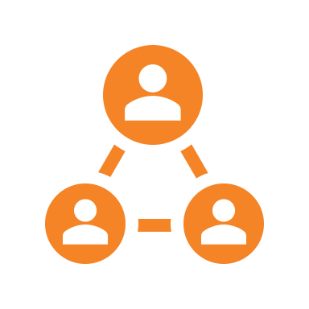
Creating Dynamic Mindsets
Change Physical Environments
Seek people who help in getting out of realism zone
Supportive people
in your community
Change mood through movement and/or exercise
Surround with people with different backgrounds, cultures, interests.

Slide 11
DEEPER CLARITY METHOD
ALIGNMENT
CONNECTION
REFRAMING
EXPERIMENTATION
1
2
3
4
Understanding shared goal(s)
Define core success
Identify Core Customer Problems
(Define Gaps)
Work with Customers to Solve Their True Problems
(Bridge Gaps)
Understand Customers
Better
PREPARATION
DISCOVERY
DEFINE
IMPLEMENT
Collaborative, Open, Clear and Authentic Mindsets
Customer-centric, Open, and Collaborative Mindsets
Open, Aspirational and Adaptable Mindset
Growth, Adaptable and Systems Mindset
www.Spring2Innovation.com | 11

Slide 12
Spring2 Journey
2011
2024

Slide 13
GROWTH MINDSET
Concept developed by psychologist Carol Dweck
Individuals can grow abilities & intelligence through effort, learning & persistence
fixed mindset individuals believe their abilities are static and unchangeable
Embraces challenges as opportunities to expand abilities
Learn from failure (see if as an opportunity to learn and improve)
Ie. after a student fails a math test, they decide to study harder, seek help, and understand their mistakes, rather than concluding they're just not good at math.

Slide 14
ASPIRATIONAL MINDSET
Desire for significant achievement or improvement, setting ambitious goals, and maintaining a positive outlook and persistent effort toward those goals.
Often driven by a clear vision of what one wants to achieve (and that they are achievable).
Leads to continuous learning, resilience, and eventually, achieving one's desired outcomes.
Global Company

Slide 15
OPEN MINDSET
Willingness to consider new ideas, perspectives, &experiences without prejudging them based on one's own pre-existing beliefs or biases.
Receptive to differing viewpoints and willing to revise one's understanding based on new information or understanding.
Characteristics include curiosity, flexibility, and a readiness to entertain the possibility that one might be wrong or that there might be more than one right answer.

Slide 16
ADAPTABLE MINDSET
Ability to adjust thoughts, behaviors, and actions in response to changing circumstances or new information.
Involves flexibility, openness to change, and the willingness to learn and evolve. - typically are resilient in the face of challenges and are able to pivot strategies or approaches when necessary.
Characteristics include resourcefulness, open-mindedness, and a proactive attitude towards change.

Slide 17
CLEAR MINDSET
Focused, undistracted mind, allowing for effective decision-making, problem-solving, and efficient handling of tasks.
Free from confusion or ambiguity, having a well-defined purpose or goal, and the ability to concentrate on what's important without being overwhelmed by irrelevant thoughts or emotions.
Characteristics include focus, organized, and have the capacity to prioritize effectively.

Slide 18
COLLABORATIVE MINDSET
Actively seek out and value working with others to achieve common goals and share knowledge.
Characterized by open communication, mutual respect, and the belief that combining the strengths & perspectives of a group leads to better outcomes than working alone.

Slide 19
AUTHENTIC MINDSET
Remains true to their own personality, spirit, or character, despite external pressures or influences. Involves a high level of self-awareness, understanding one's values, beliefs, and desires, and acting in a way that is consistent with them.
Characteristics include honesty, integrity, and a strong sense of self, often leading to genuine and transparent interactions with others.

Slide 20
CUSTOMER CENTRIC MINDSET
Prioritizes the needs, experiences, and satisfaction of customers in every aspect of their operations and decision-making.
Emphasizes understanding and addressing the needs and expectations of customers, with the goal of providing exceptional service and value.
Key characteristics include empathy, responsiveness, and a strong focus on building long-term relationships with customers.

Slide 21
SYSTEMS MINDSET
A holistic approach to analysis that focuses on the way that a system's constituent parts interrelate and how systems work over time and within the context of larger systems
Instead of focusing on individual parts, look at the system as a whole. Understand the system's purpose, goals, and how it fits into the larger context or environment.

Slide 22
What are the different types of initiatives Deeper Clarity Can be Applied to ?
Innovation
Creating new products, services and processes
Digital Transformation – introducing or developing new technologies
Customer Experience
Create more stickiness with customers (loyalty)
Increase number of customers (How can we close more sales?)
Have customers buying additional services and products from you
Create better customer experiences (reduce complaints, make it easier for customers to do business with you)

Slide 23
Starting Projects
How much is spent at the start of a project?
How much is it worth to you to get going in collaboration faster?

Slide 24
People
Technology
Process
ACTIVITY IN TEAMS
Which areas are your challenges in?

Slide 25
Self Assessment
Leadership
Approach
Project
Approach
ACTIVITY IN TEAMS
How do these mindsets connect with the methodology?

Slide 26
Self Assessment
A) Alignment
B) Innovation
SCORES
C) Process
D) End-user driven

Slide 27
The Deeper Clarity Method™ The Top 10 Ways To Build Products, Processes, Policies & Services Using
1. Align Common Understanding: Ensure all team members start with a shared definition and understanding of the project's goals and objectives. (Collaborative mindset)
2. List Initial Challenges: Gain an understanding of the top challenges of the users you’re solving the problem for. (Open Mindset)
3. Set Clear Success Metrics: Define the measurable success criteria in a concrete and unambiguous manner. (Clear & Authentic Mindset)
4. Use a Customer-Centric Approach: Identify and empathize with the individuals or groups who will be affected by the project's outcomes. Gain insights into how customers envision their problem solved. (Customer-centric mindset)

Slide 28
The Top 10 Ways To Build Products, Processes, Policies & Services Using The Deeper Clarity Method™
5. Escape the Gut Assumption Trap: Validate assumptions by seeking direct feedback from customers. (Open mindset)
6. Reframe the Problem: Incorporate customer insights and debunked assumptions to redefine the initial problem statement, ensuring accuracy and relevance. (Open Mindset)
7. Foster Dynamic Mindset: Encourage innovative thinking by being open to new methods, approaches and solutions. Create a psychologically safe environment where diverse team members can openly share ideas and perspectives without biases. (Aspirational Mindset)

Slide 29
The Top 10 Ways To Build Products, Processes, Policies & Services Using The Deeper Clarity Method™
8. Ideate and Evaluate: Foster creativity through diverse brainstorming techniques and evaluate solutions for feasibility, desirability, and viability. (Aspirational Mindset)
9. Prototype and Test: Develop low-fidelity prototypes and engage customers in testing and providing feedback. (Growth Mindset & Adaptable Mindset)
10. Ensure Continuous Alignment: Regularly review progress against success metrics and adapt them based on new insights to ensure the project remains aligned with its intended impact. (Growth Mindset & Adaptable Mindset & Systems Mindset)

Slide 30
Innovation Literacy Skills
Alignment
Connect
Reframe
Experiment
{Reframe}
Knowledge Transfer & Execution
Notes:
Save time and money
Feel more excited and confident
Successfully achieve your goals

Slide 31
OUR THREE PROGRAMS
Level 1
Design Thinking Level 1
Advance Application of Design Thinking
Learn The Deeper Clarity Method™
Deeper Clarity Project Assessment
Project Alignment Training Deeper Clarity Roadmap
Deeper Clarity Solutions Project Implementation*
The Deeper Clarity Audits
Level 2
Deeper Clarity Solutions™
License to Deeper Clarity Method
Comprehensive Resources, including Deeper Clarity Method Manual & Guide
Subscription to regular updates and access to S2 Material
Level 3
Enterprise-Wide Deeper Clarity Solutions™
Add
ons
Leadership Coaching
Mindset Coaching
External Project Audits
Project Test Cases
Deeper Clarity Facilitation and Methodology Coaching

Slide 32
The Deeper Clarity Process™
1. Join The Deeper Clarity Network (Free Subscriber)
2. The Deeper Clarity Assessment
3. Join The Deeper Clarity Program (Member)
4. Create Your Deeper Clarity Plan
5. Select Deeper Clarity Resources
6. Implement Your Deeper Clarity Plan
7. Review Progress Regularly

Slide 33
Questions For Leaders
How might I shift my mindset?
What mindset landed with you?
How might I use this mindset in the next week in my work?
Notes:
Who are highly innovative organizations?
Highly successful companies, like Tesla Motors, Procter & Gamble, David’s Tea and Uber are among those that are constantly on the cutting edge of innovation, considering the needs of their end-user is intrinsic to their culture.

Slide 34
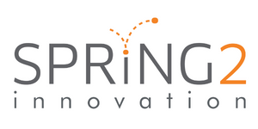
Connect with Us
Nilufer Erdebil is an award-winning design thinking and innovation expert, engineer, author, and a TEDx and TEC speaker. She has worked extensively with public and private sector organizations to drive strategy, facilitate change and introduce new products and services. Her background in engineering and her experience working within different fields including telecommunications, application development, program management and IT management give her a deep understanding of the business challenges today’s organizations are faced with.
Nilufer@spring2innovation.com
613-850-0854
Nilufer Erdebil
Founder & CEO
Design Thinking for Complex Environments (watch the video here)
www.spring2innovation.com
@Spring2Innovation
info@spring2innovation.com
@Spring2inno

Slide 35
“The steps that are covered in this book,
especially empathizing with the clients or end users, was a critical success factor in the release of the new digitized application process and has a direct impact on the lives of Canadians.”
Jason Mombourquette - Director General, RCMP
AVAILABLE NOW
www.futureproofingbydesign.com

Slide 36
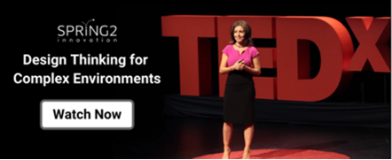
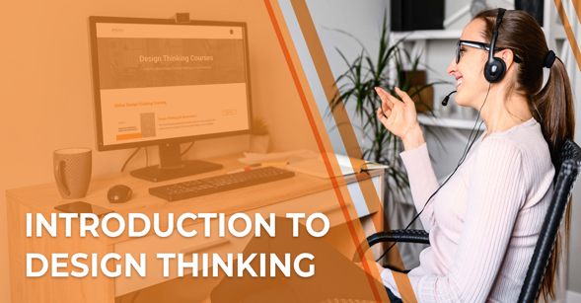
LEARN MORE ABOUT DEEPER CLARITY
NEW!
Steps of Design Thinking
Spring2 Innovation’s YouTube Channel
Better Thinking by Design
Coaching & Consulting
Instructor-Led Training
Self-led Training
LET’S TALK
info@spring2innovation.com
www.spring2innovation.com
Notes:
Modify the images

