Slide 1
Leading with Emotional Intelligence and
Resilience in Times of Uncertainty

Slide 2
Agenda
PART 1 An Introduction to Emotional Intelligence
PART 2 Understand Our Current Environment
PART 3 An Introduction to Emotional Resilience
PART 4 Strategies for Enhancing Emotional Intelligence

Slide 3
Learning Objectives
Define emotional intelligence (EI) & resilience
Describe the connection between EI and leadership
Apply 2-3 strategies for enhancing EI & resilience

Slide 4
PART 1 An Introduction to Emotional Intelligence

Slide 5
Emotional Intelligence (EI) refers to your ability to recognize and manage emotions effectively – yours and others’.
EQ is the scientific measure of EI

Slide 6
90% of top performers are also
high in EQ
Out of 33 workplace skills, EQ was the strongest predictor of success accounting for 58% of a persons’ job performance.
Employees who had managers with high EQ were 4x less likely to leave than those with low EQ
More than 70% of an employees view of the organizational climate
directly results from their managers emotional intelligence.
EQ was 4x more likely to predict career success
In senior leadership roles, EI makes up about 80%-90% of the differentiating competencies

Slide 7
EQ
PEOPLE SKILLS
FLEXIBILITY
RESILIENCE
Threshold
IQ
EDUCATION
TECHNICAL SKILL
JOB KNOWLEDGE

Slide 8
Flexibility
Empathy
Optimism
Confidence
Assertiveness
Self-Awareness
Stress Tolerance
Problem Solving
Relationship Skills

Slide 10
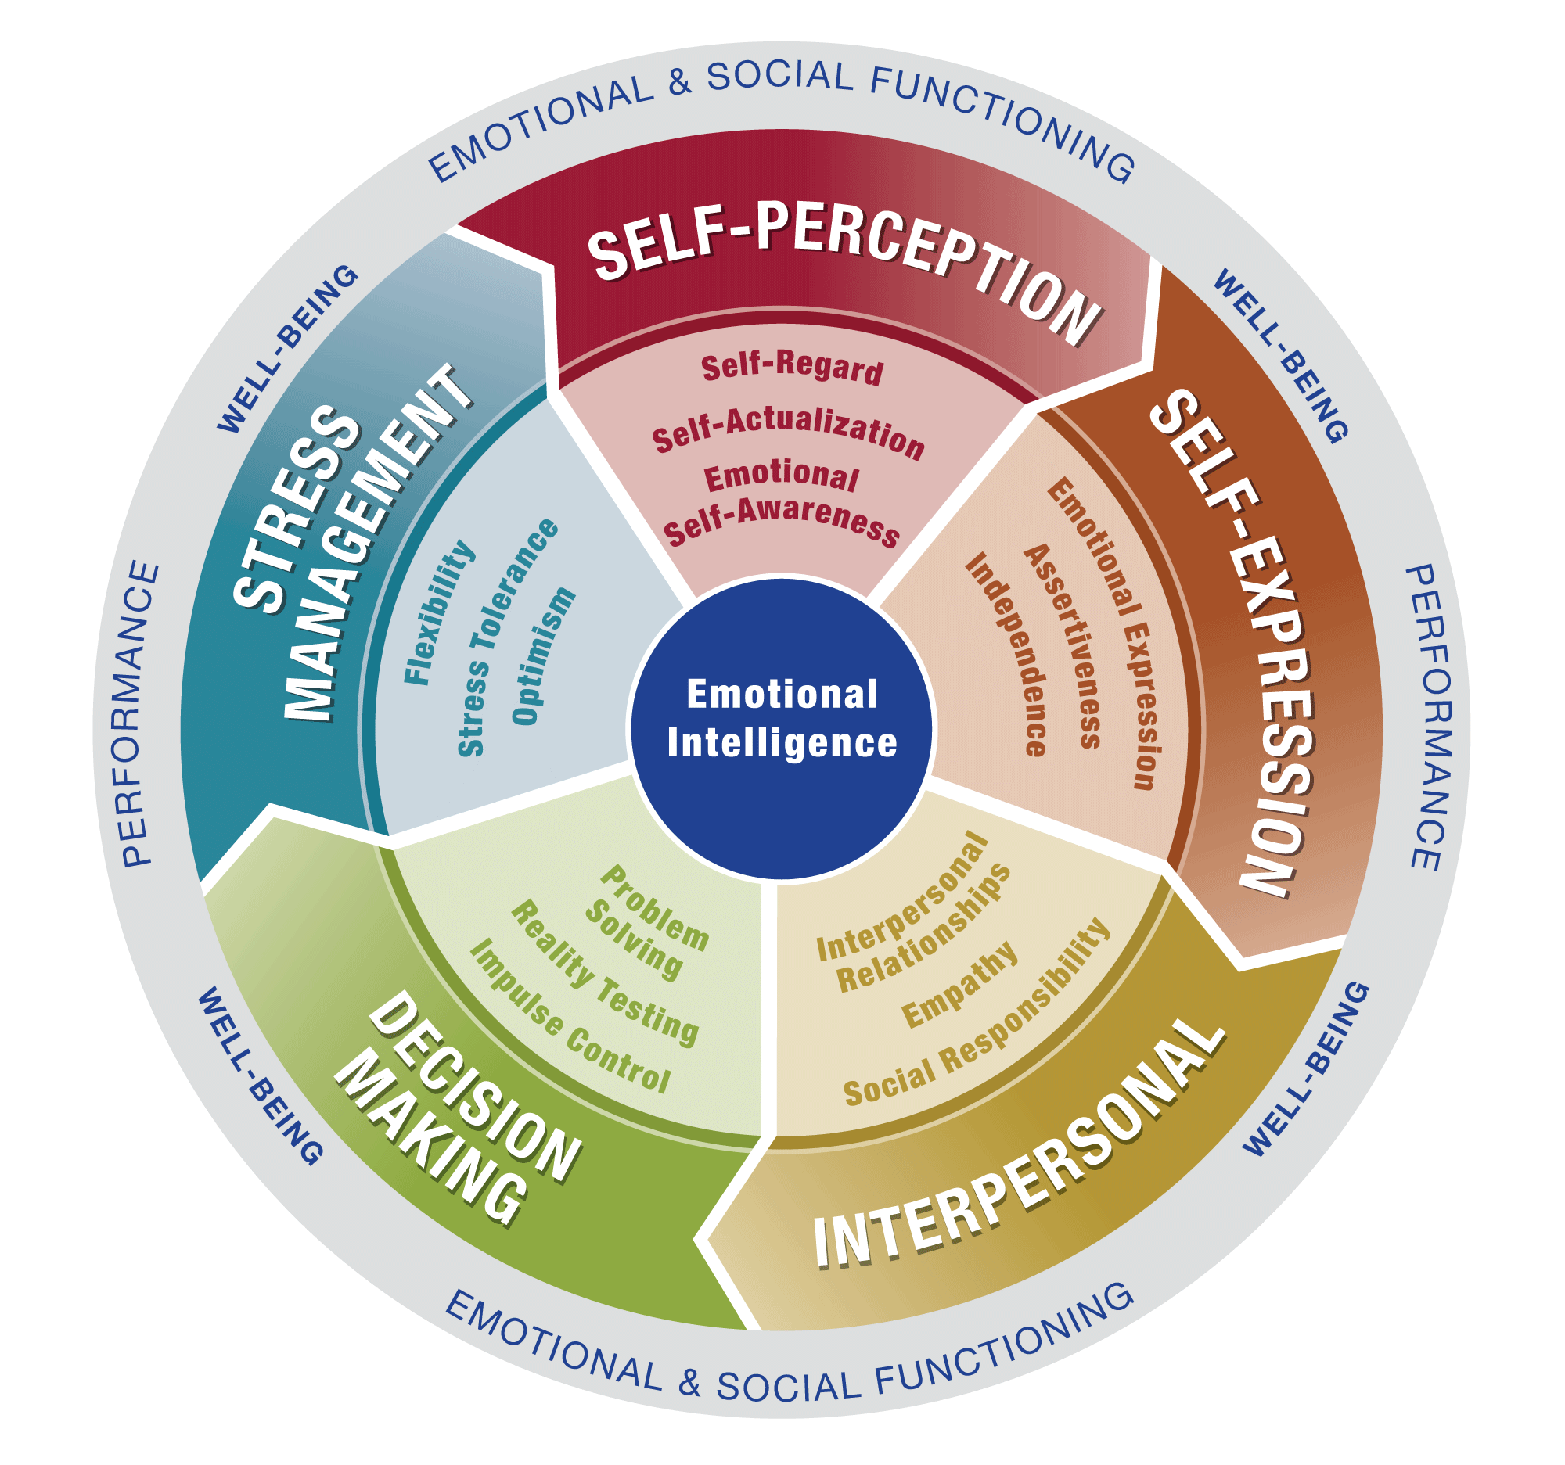

Slide 11
Notes:
CASE STUDY 2 - SARAH
Sarah is a senior leader at a rapidly growing startup technology company. She’s incredible smart, experienced and driven. Her team looks up to her and together, they’ve been able to accomplish some incredible things, especially within the past year. However, within the past few months there’s ben a building tension between team members towards her that she is not aware of. This comes from the way that she delivers feedback. Sarah is a straight to the point kind of gal. When something goes wrong, or a team member makes a mistake, she just calls it out without much consideration for how it might be received. In the last meeting, she raised her voice at Jim for misquoting numbers for one of their major client account, and this happened in front of the entire team. She continued to scold him publicly before correcting his error and telling him how to do it right. Going forward, Jim is definitely more careful because of this experience as well as others, but he’s also less likely to bring forward any challenges he’s facing for fear of humiliation.

Slide 12
What is the imbalance pair?
What is the business impact?

Slide 13
Assertiveness
Empathy
Notes:
What do you currently know about emotional intelligence?
What would you like to take away from this session?

Slide 14
Flexibility
Empathy
Optimism
Confidence
Assertiveness
Self-Awareness
Stress Tolerance
Problem Solving
Relationship Skills

Slide 15
Flexibility
Empathy
Optimism
Confidence
Assertiveness
Self-Awareness
Stress Tolerance
Problem Solving
Relationship Skills

Slide 16
How does resilience apply to
our current environment?

Slide 17
PART 2 Understanding Our Current State

Slide 18
The Modern World

Slide 19
What is the current reality of how we experience stress today?

Slide 20
52% of workers say they are stressed at work on a daily basis
60% say that work related pressure has increased in the last 5 years
46% of HR leaders say burnout is responsible for up to half of turnover

Slide 21
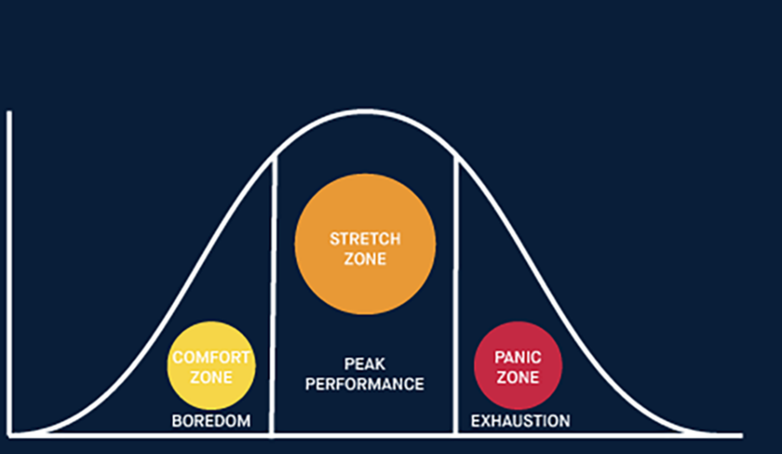
Performance
Pressure

Slide 22
You Are
Here
Performance
Pressure

Slide 23
For the first time ever, burnout has been recognized as an official medical diagnosis by The World Health Organization. (As of May 2019)

Slide 24
Your brain on stress…

Slide 25
Sympathetic
Nervous System (SNS)
Adrenaline secretion
Sends blood to large muscles (survival)
Pulse rate and blood pressure increase
Breathing becomes faster and shallower
Cortisol enters the blood stream
Cortisol: Diminishes the immune system
Cortisol: Inhibits neurogenesis
Cognitive, perceptual and emotional impairment

Slide 27
What if you’re here?
Performance
Pressure

Slide 28
We need emotionally resilient
leaders more than ever.

Slide 29
PART 3 Defining Emotional Resilience

Slide 30
Resilience is the ability to endure, recover from, and find balance,
in the midst of adverse situations.

Slide 31
According to leading research, there are three mindset qualities that predict how resilient a person will be in difficult times…
Challenge, Control & Commitment

Slide 32
Challenge
Seeing change and new experiences as exciting opportunities to learn and develop

Slide 33
Challenge
Seeing change and new experiences as exciting opportunities to learn and develop
What is this situation teaching me?
What skills can I learn that would be helpful?
How can I use this situation to my/our advantage?

Slide 34
Control
Beliefs in one’s ability to control or influence outcomes

Slide 35
Control
Beliefs in one’s ability to control or influence outcomes
What is within my control?
What is outside of my control?
How can I limit my focus of what I can’t control?
How can I enhance my focus of what I can control?

Slide 36
Commitment
A tendency to see the world and day-to-day activities as interesting, meaningful and having purpose

Slide 37
Commitment
A tendency to see the world and day-to-day activities as interesting, meaningful and having purpose
What is my “Why”
What is the vision here? Where are we going?
What is the greater impact of the day-to-day?

Slide 38
Recovery / Renewal
New studies show that being resilient is not only about how you deal with challenges, but how you recover.

Slide 39
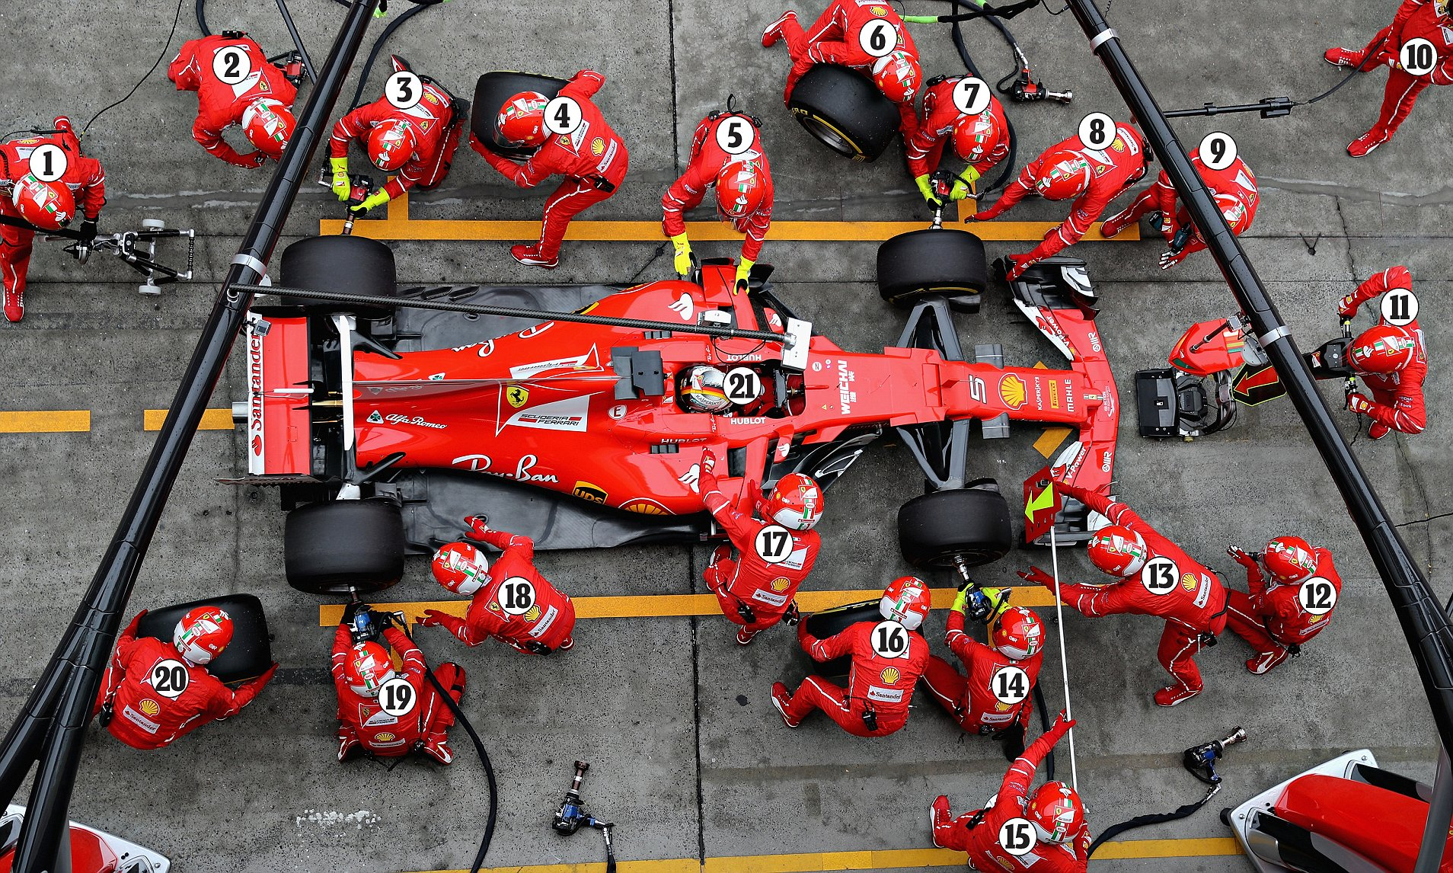
PIT STOP

Slide 40
Slow is smooth,
and smooth is fast.
PIT STOP

Slide 41
Your brain on renewal…

Slide 42
Parasympathetic
Nervous System (PNS)
Activates the renewal process: removes damaged cells, neutralizes toxins, destroys free radicals, reduces stress hormones, improves digestion, relaxes muscles
Releases oxytocin and vasopressin, opens blood flow
Bloor pressure and blood rate drop
Breathing slows and gets deeper
Engages your immune system to its fullest capability

Slide 43
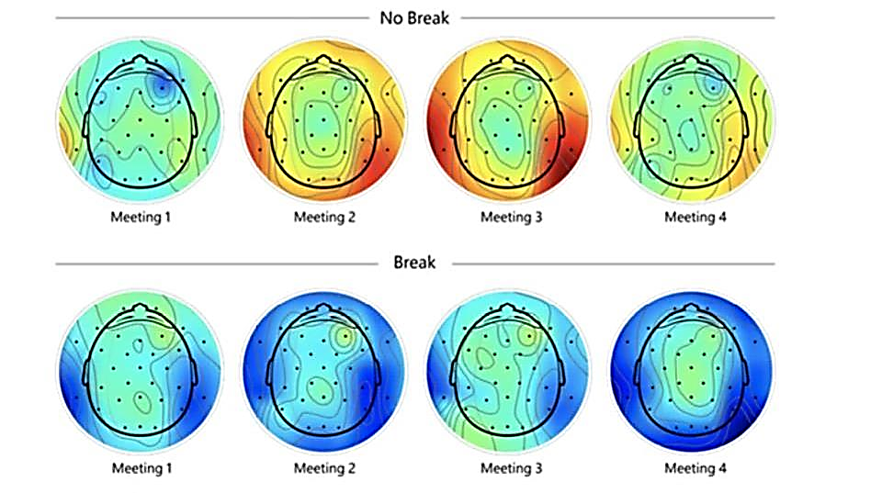
Less Stress More Stress

Slide 44
Recovery / Renewal
Do you recover well?
What is my renewal strategy – do I even have one?
How many hours did I commit to renewal this week?
Check-in: What is my mood – do I need to manage it?

Slide 45
PART 4 Emotional Intelligence Strategies

Slide 46
Can emotional intelligence be learned, or is it something that you are born with?

Slide 47
Experience
Reflect
Experiment
Concept

Slide 48
Strategies for Enhancing Your Resilience
Clarify The 3 C’s: Identify and clarify how Challenge, Control, and Committment can work for you in the midst of a difficult situation
Proactively Manage Stress: Identify and mange your triggers, Intentionally engage in activities that empty your stress bucket, schedule space into your calendar
Create A Recovery Strategy: Create ways to regain balance and find the center again. This can be exercise, time with family, meditation, or even a spa day. Getting back to zero often, is key.

Slide 49
Strategies for Enhancing The EQ of Your Leaders
Education: Provide means for your teams to learn about what emotional intelligence/resilience is and why these skills are critical in today's environment.
Awareness: Help leaders gain awareness of their own EI strengths and opportunities – Employee Surveys, Conversations, Psychometrics (360’s) etc.
Experiential Learning: Supplement conceptual learning with on-going coaching or training to create behavioral change in opportunity areas. (Culture)

Slide 50
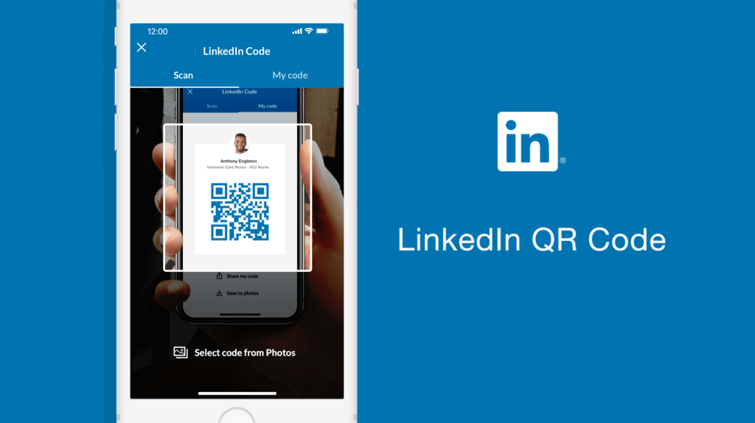
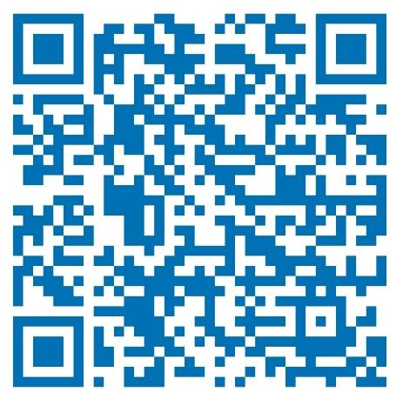
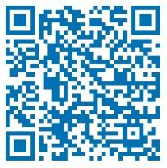
Questions
& Answers
LinkedIn: Jamelle Lindo, CTP, ACC
Jamelle.Lindo@ParadigmPD.com
Website: JamelleLindo.com
Phone: 1-833-777-5965 x1

