Slide 1
“Who am I becoming while I am busy doing?”
~ Dr. Mary Crossan
Dr. Dusya Vera

Slide 2
WHO WE ARE
The Ian O. Ihnatowycz Institute for Leadership aims to develop global citizens who have strength of character, strive to make a difference, and contribute to the flourishing of teams, organizations, communities, and societies.
RESEARCH
OUTREACH
STUDENT
PROGRAMMING
CROSS-CAMPUS

Slide 3
OUR BEGINNING
An exploration into the 2008 financial crisis

Slide 4
MENTIMETER
How would you describe the character of a leader?

Slide 5
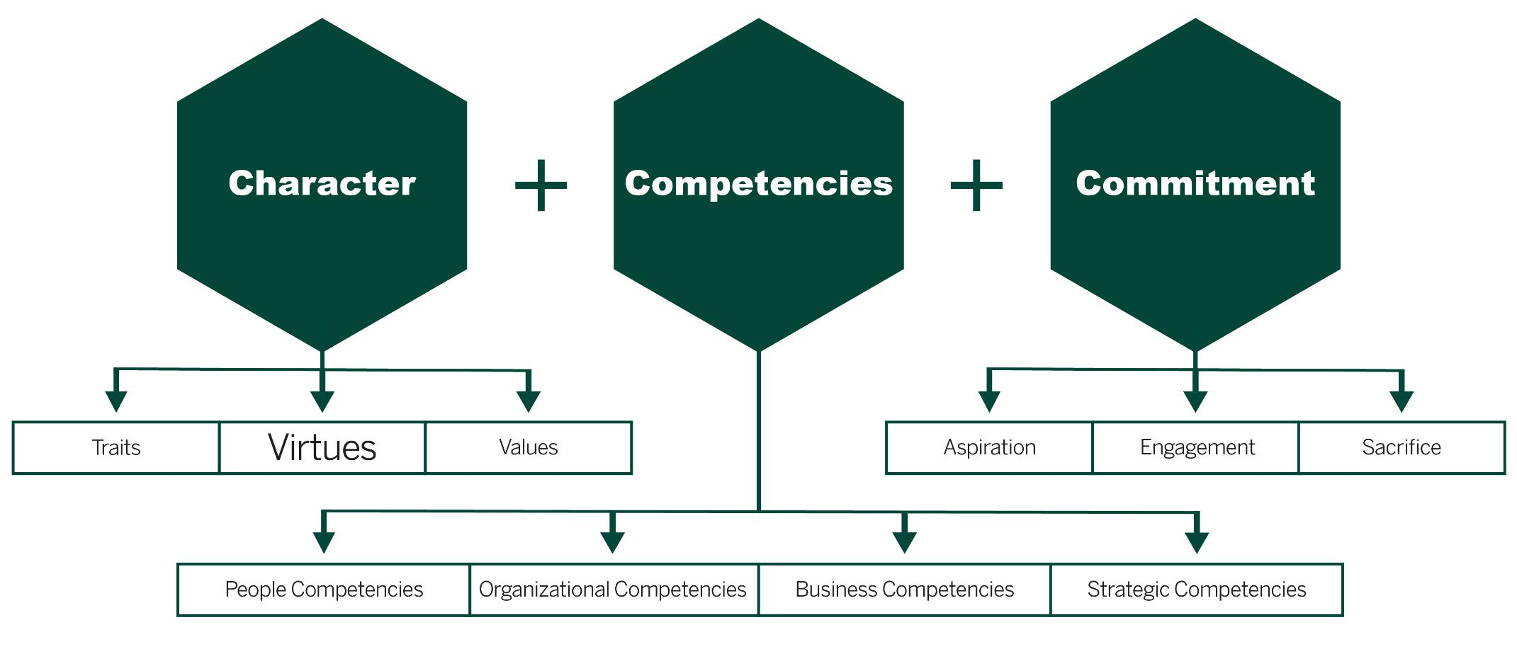
THE EFFECTIVE LEADER
Leadership is a function of character, competencies and commitment

Slide 6
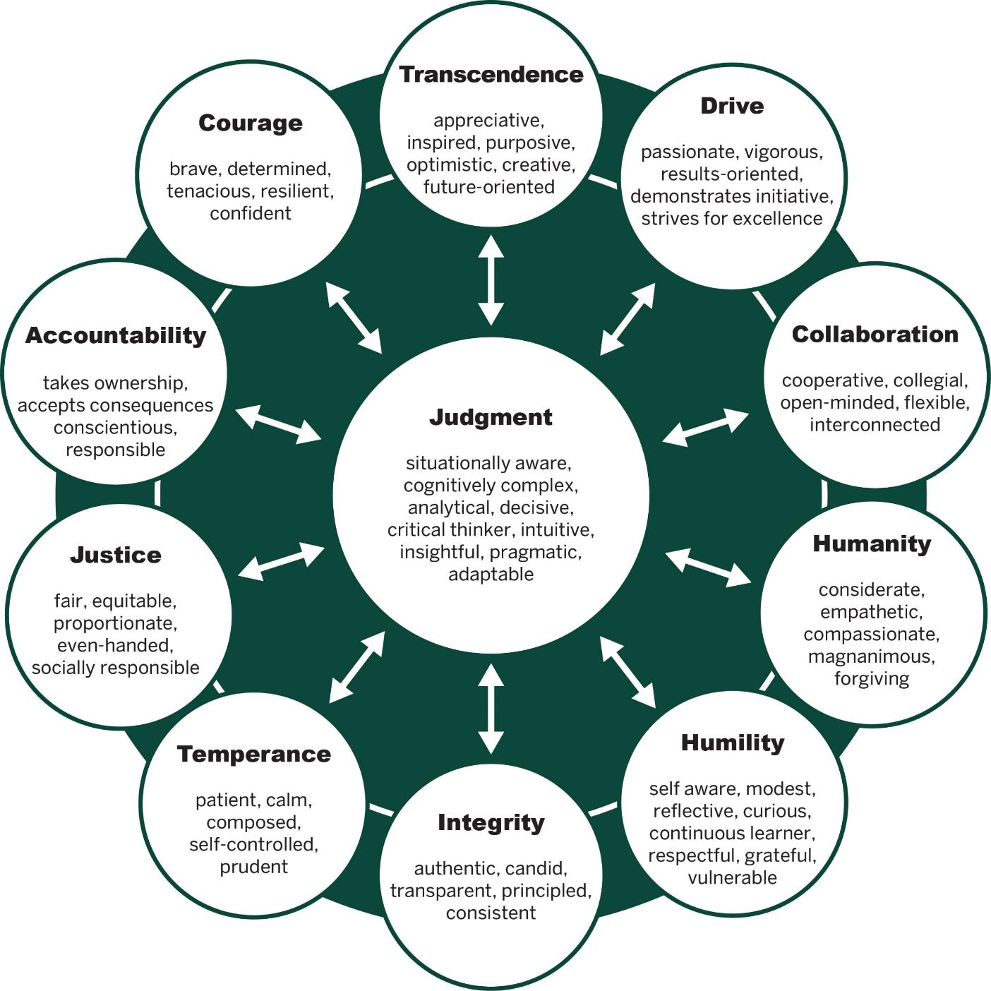
OUR FRAMEWORK
Character is a “habit of being.”
Character-based judgment supports superior performance, sustained excellence, and well-being
Crossan, M.; Byrne, A.; Seijts, G. Reno, M.; Monzani, L., Gandz, J.: “Toward a Framework of Leader Character in Organizations” Journal of Management Studies, 2017

Slide 7
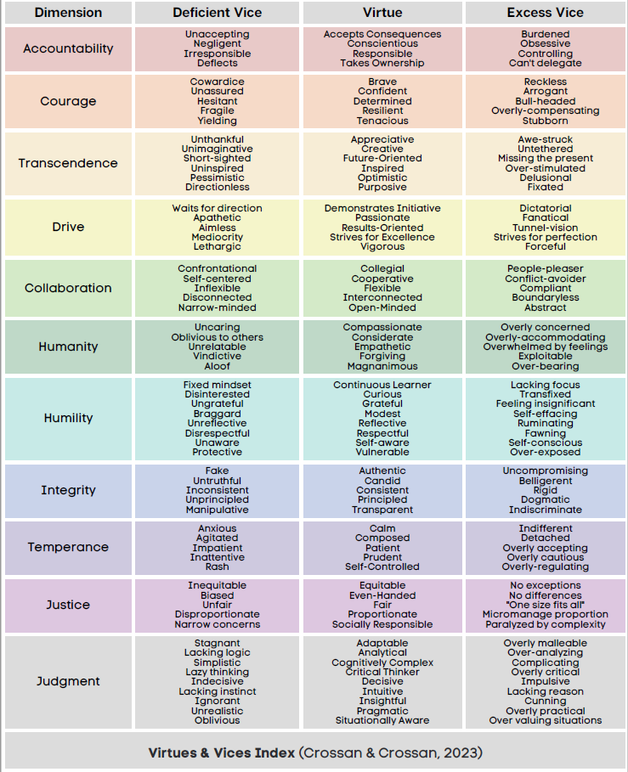
VIRTUES AND VICES
Courage / Confident
Unassured Arrogant
(deficient) (unsupported)
Cooperative / Conflict-avoider
Self-centered Conflict-avoider
(deficient) (unsupported)
Integrity / Principled
Unprincipled Dogmatic
(deficient) (unsupported)

Slide 8
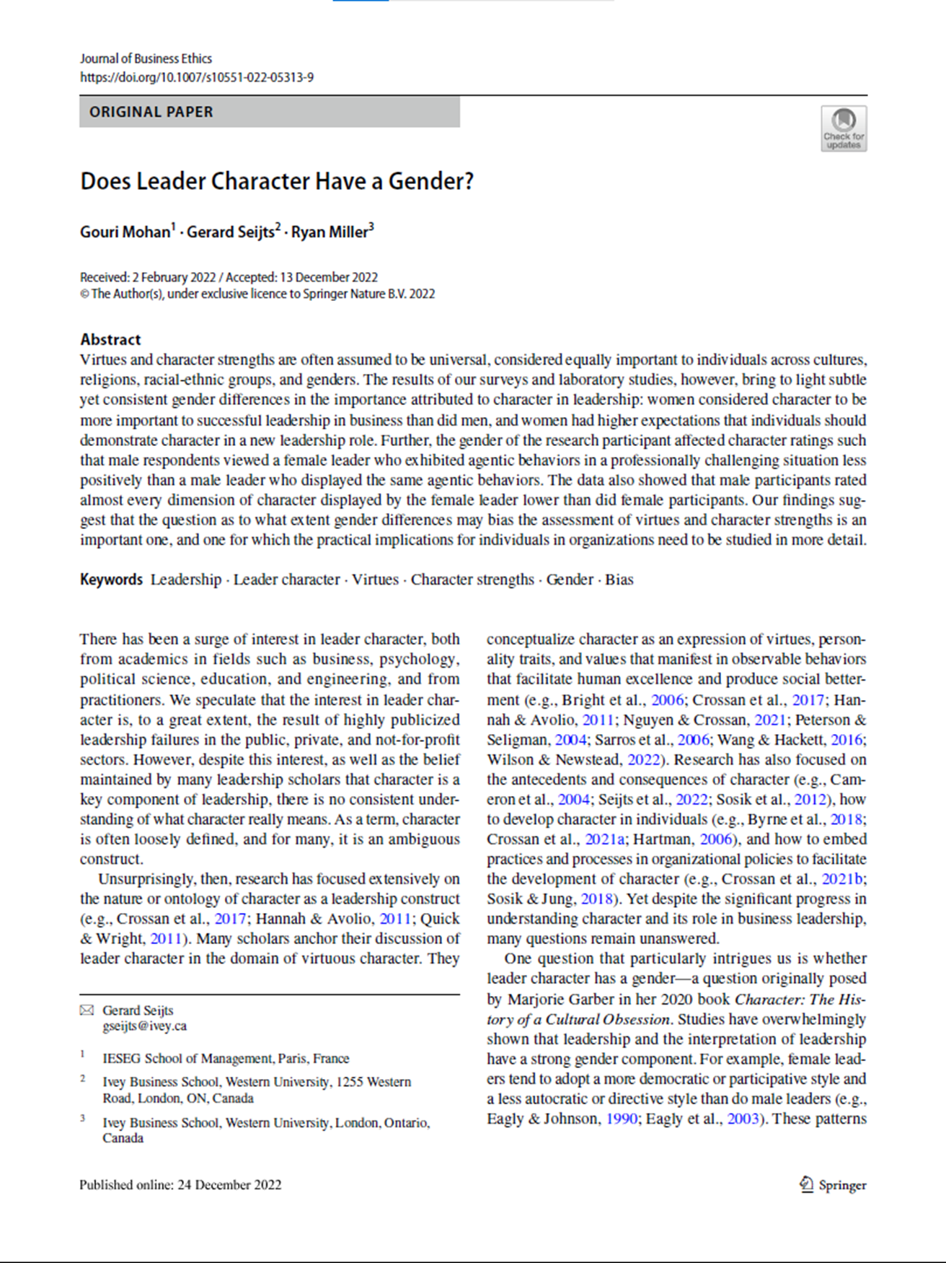
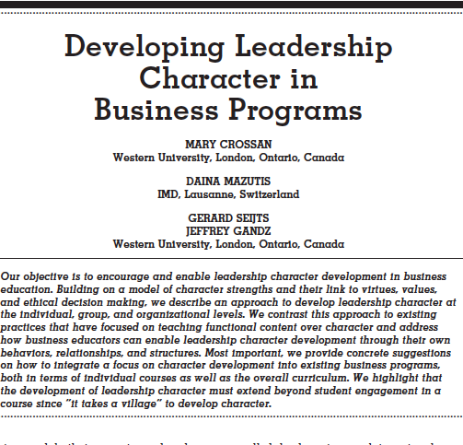
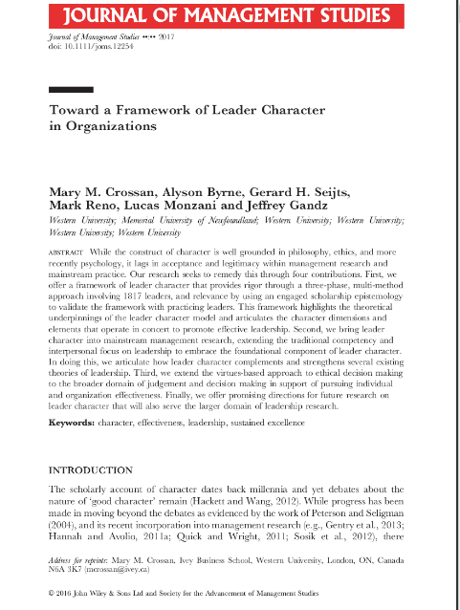
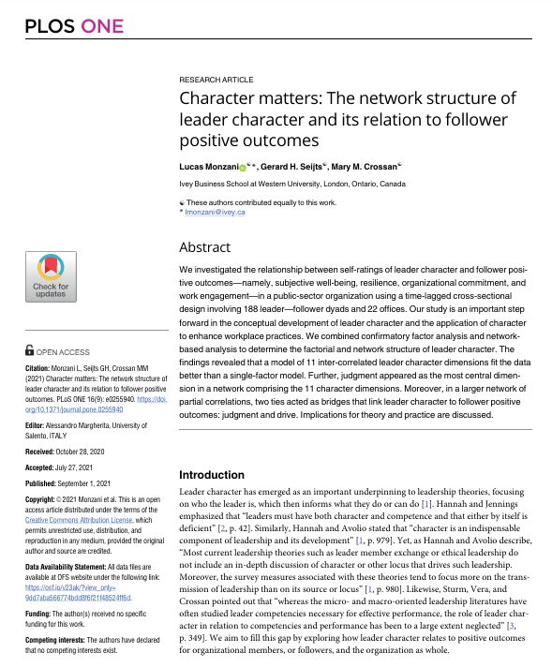
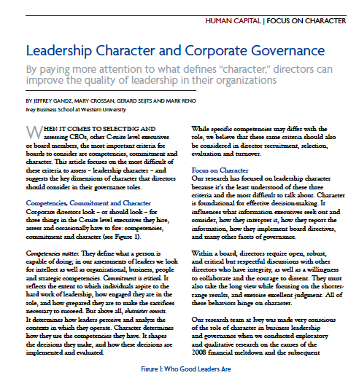
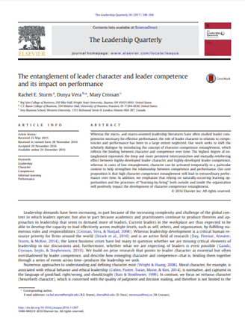
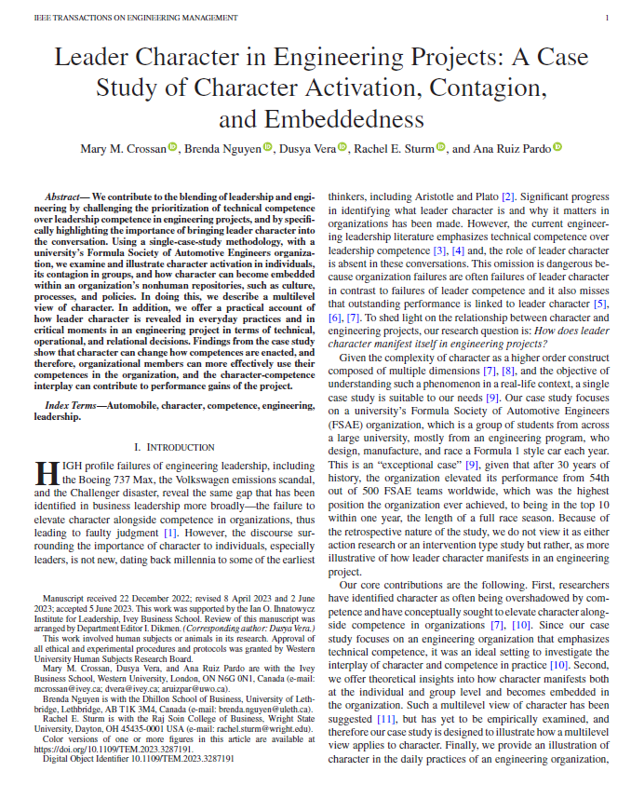
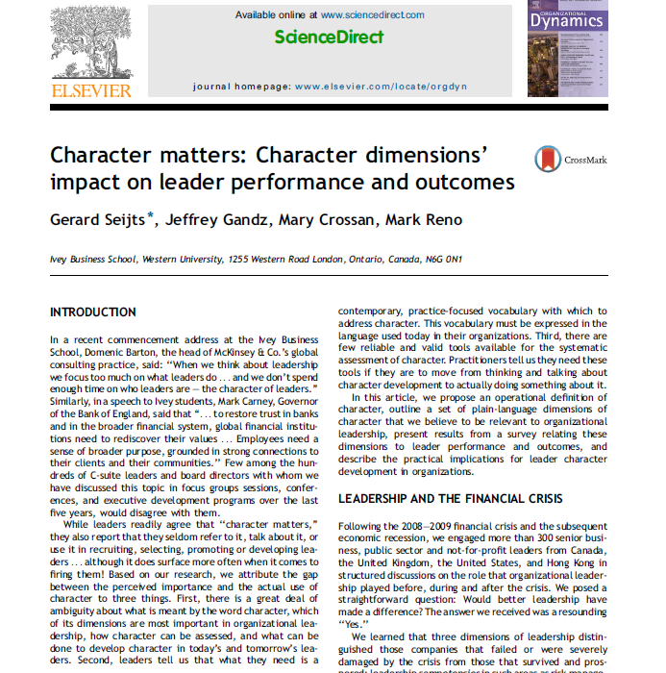
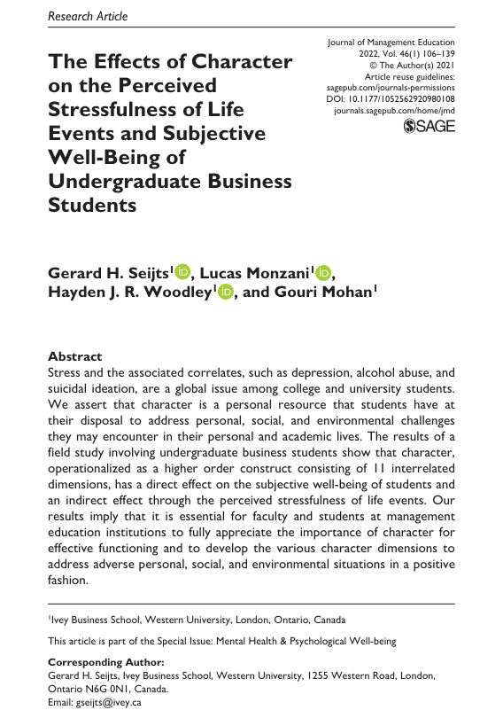
RESEARCH

Slide 9
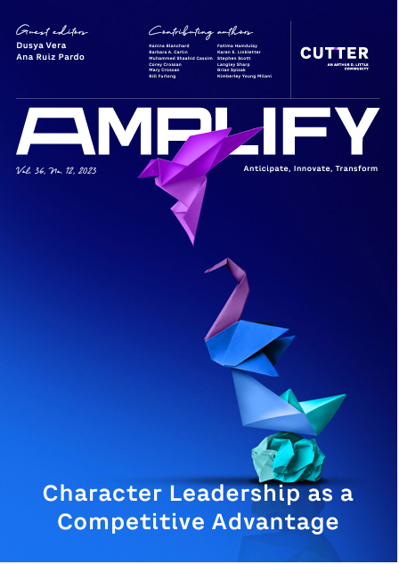
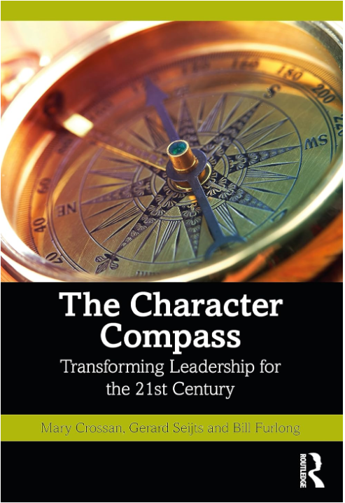
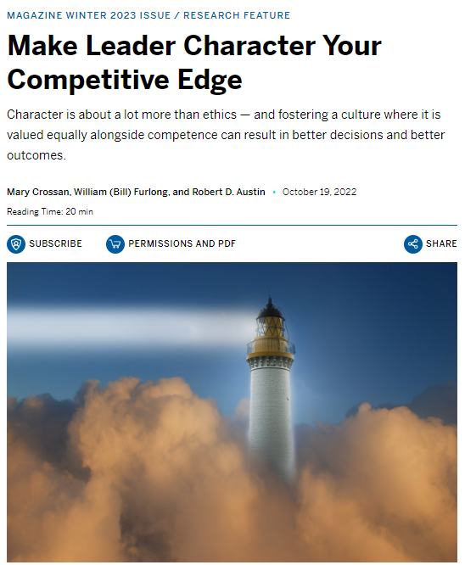
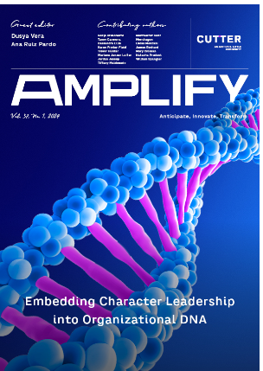
RESEARCH INTO PRACTICE

Slide 10
EVIDENCE-BASED
Winners of the 2024
“Evidence-based Leadership Development Program”
from the Academy of Management – Management Education Development (MED) Division

Slide 11
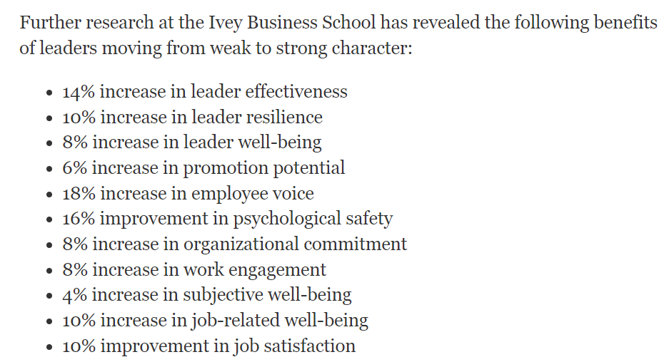
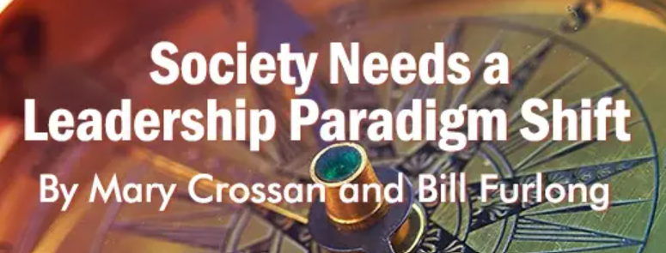
Based on databases used in: Crossan, M. M., Byrne, A., Seijts, G. H., Reno, M., Monzani, L., & Gandz, J. (2017). Toward a framework of leader character in organizations. Journal of Management Studies, 54(7), 986-1018. Monzani, L., Seijts, G. H., & Crossan, M. M. (2021). Character matters: The network structure of leader character and its relation to follower positive outcomes. PLoS One, 16(9), e0255940.
EVIDENCE-BASED
https://www.leadershipnow.com/leadingblog/2023/12/society_needs_a_leadership_par.html

Slide 12
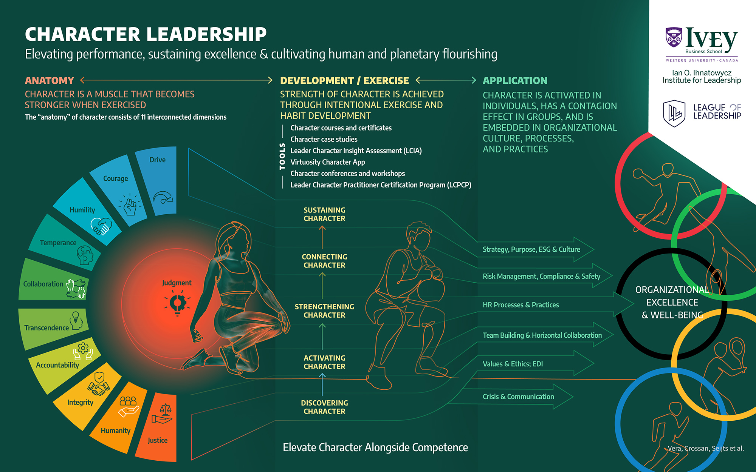

Slide 13
Who am I becoming while I am busy doing? ~Dr. Mary Crossan
HOW IS CHARACTER DEVELOPED
Am I becoming more courageous or less courageous?
More humble or less humble?
More patient or less patient?

Slide 14
DEVELOPING CHARACTER
Crossan, Ellis & Crossan, 2019

Slide 15
SEVEN STRATEGIES FOR CHARACTER DEVELOPMENT
Lamb et al., 2021

Slide 16
PABC’S UNDERPINNING CHARACTER DEVELOPMENT
Context, Environment, Situation
Cognition
Behaviour
Affect: Mood, Feelings, Emotions
Physiology
Crossan, Ellis & Crossan, 2021, 2023

Slide 17
SYSTEMS SUPPORTING CHARACTER DEVELOPMENT
Ability
Attitude
Peers
Lifestyle
Culture
Perceived ease or difficulty of cultivating virtue
Presence of practices to support or inhibit virtues
Perceived favourable or unfavourable outcomes
Virtuous normative behaviors or not
People of importance supporting or inhibiting
Crossan & Crossan, 2023

Slide 18
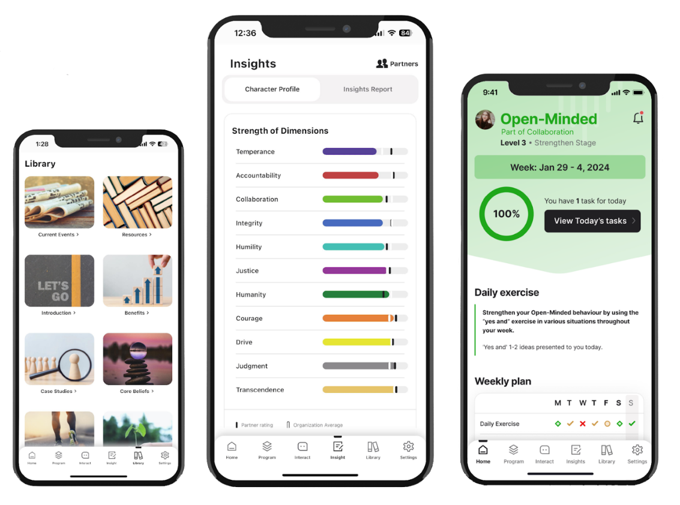
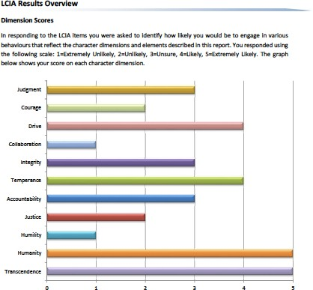
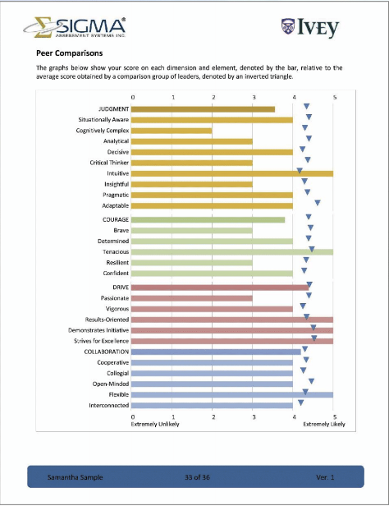
CHARACTER DEVELOPMENT TOOLS
Leader Character Insight Assessment (LCIA)
Virtuosity App

Slide 19
Character Dimensions | Exercise Suggestion(s)
All Dimensions | Listen to Music
Accountability | Identify one person or thing to which you are accountable to each day and deliver on it
Courage | Implement a more comprehensive preparation process; Do one thing outside your comfort zone
Transcendence | Set intentions; Reframe tasks to inspire
Drive | Define and measure your success; Enhance the basics (nutrition, exercise, sleep)
Collaboration | Choose one conversation each day to “yes-and” as opposed to “no-but”
Humanity | Find a commonality and a difference with a teammate
Humility | Acknowledge those who contributed to your successes; Reflect each night; Gratitude list
Integrity | Implement actions that align with your values/beliefs
Temperance | Exercise deep breathing; Mindful training
Justice | Identify one instance of injustice each day – examine why it exists
Judgment | Identify intuition vs analytical thoughts that govern your actions; Prioritize commitments

Slide 20
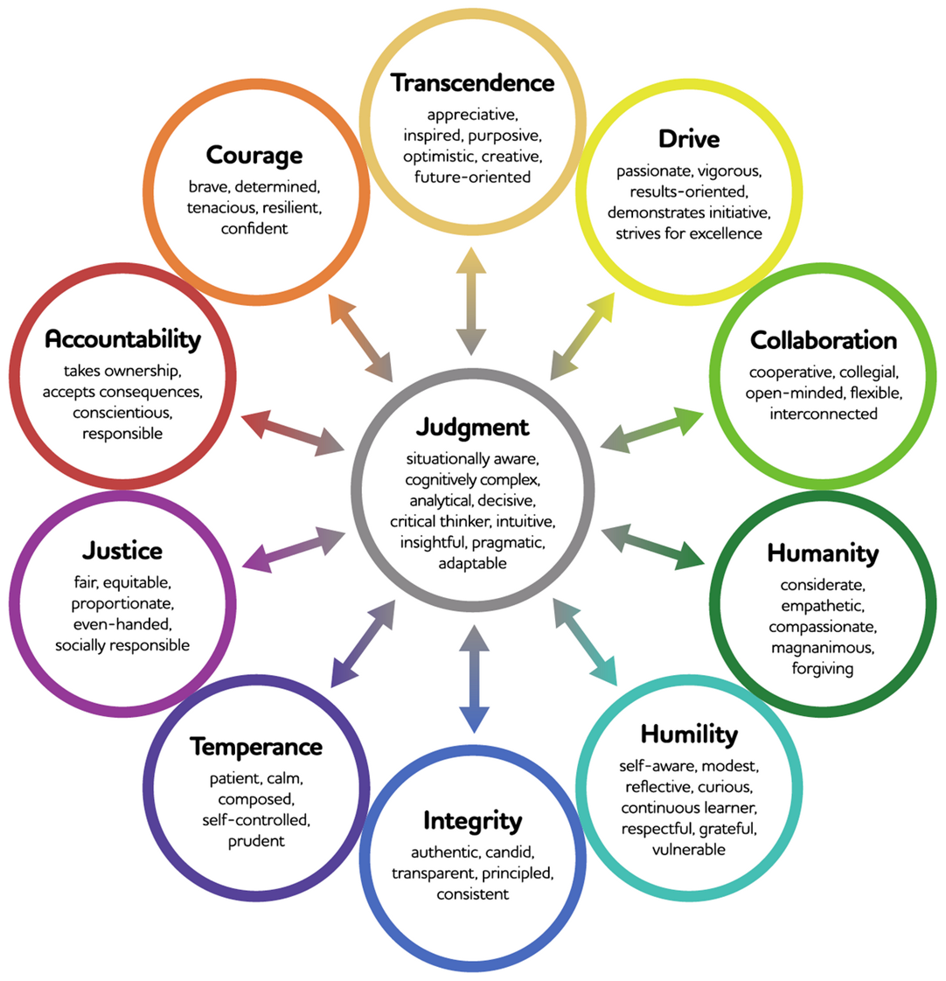
INFORMAL SELF-ASSESSMENT EXERCISE
Assess yourself on a likelihood of 0-10 with 0 being “never exhibit the behavior” to 10 “always exhibit the behavior”.
List the dimensions from strongest to weakest.

Slide 21
MENTIMETER
Rank order your dimensions of character from strongest to weakest.

Slide 22
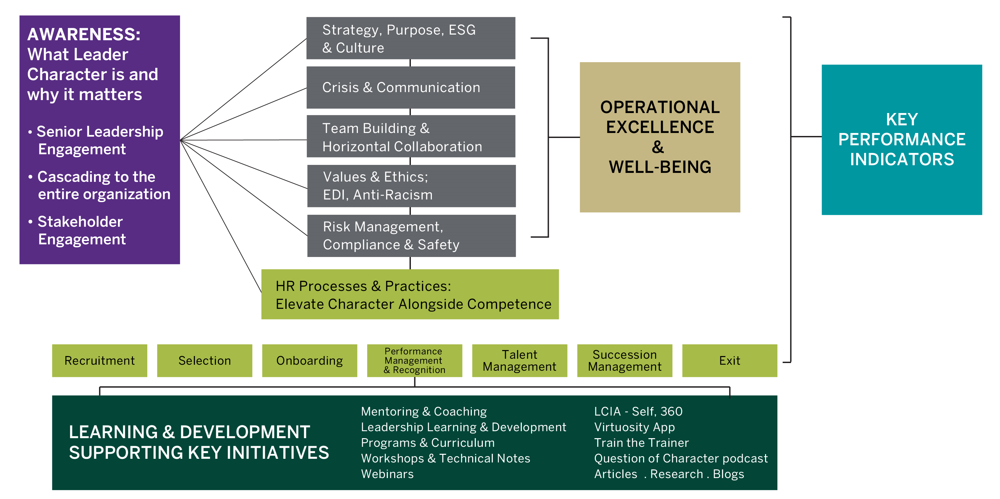
LEADER CHARACTER STRATEGIC ROADMAP

Slide 23
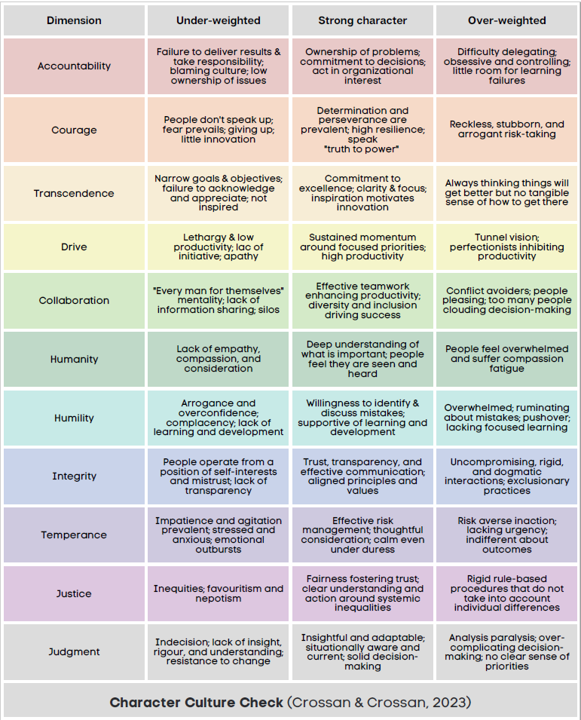
CHARACTER-INFUSED CULTURE

Slide 24
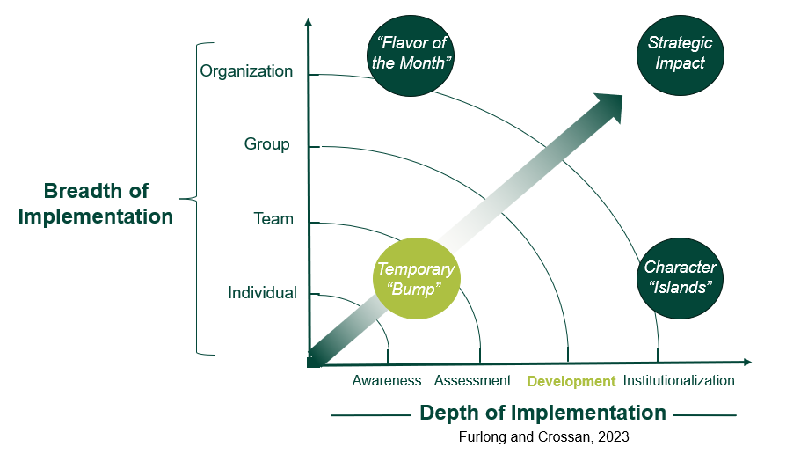
LEADER CHARACTER IMPACT VECTORS

Slide 25
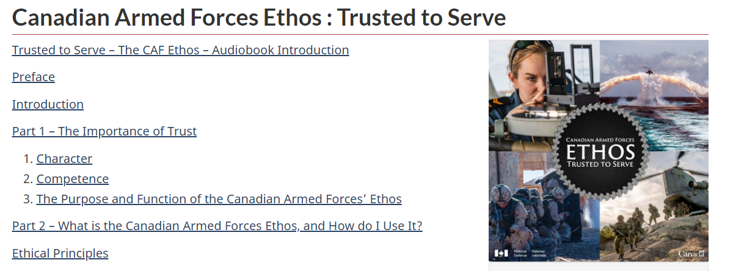
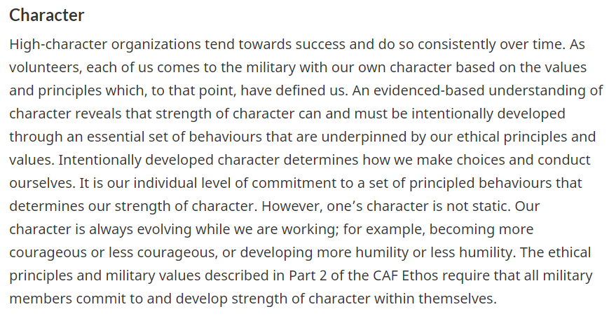
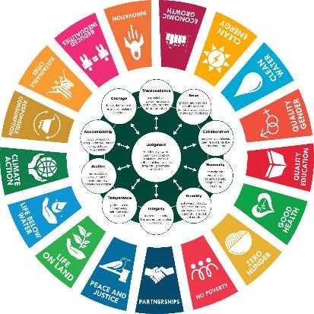
IMPACT

Slide 26
WHAT CAN I DO NEXT?

Slide 27
RESOURCES & CONTACT INFO
For articles, videos and webinars on leadership and leader character, links to our social media and for full contact information, visit: www.ivey.ca/leadership
Follow us on: Linkedin.com/showcase/iveyleadership
@iveyleadership
leadership@ivey.ca

Slide 28
