Slide 1
Selection of employees for retention or lay-off
Public Service Commission (PSC)
Association of Professional Executives of the Public Service of Canada(APEX)
February 24, 2026

Slide 2
Session objective
Provide an overview of the selection of employees for retention or lay-off (SERLO) within the context of workforce adjustment (WFA).

Slide 3
Roles and responsibilities in a WFA
Treasury Board Secretariat (TBS)
  WFA policies / directives
  Provision of WFA guidance & monitoring
Public Service Commission (PSC)
  SERLO regulatory framework and guidance
  Priority entitlements
  Monitoring application of SERLO processes & Priority entitlements
Deputy Head (DH)
  HR Planning
  Implement WFA exercise (including SERLO if required)
  Collaborate with TBS & PSC

Slide 4
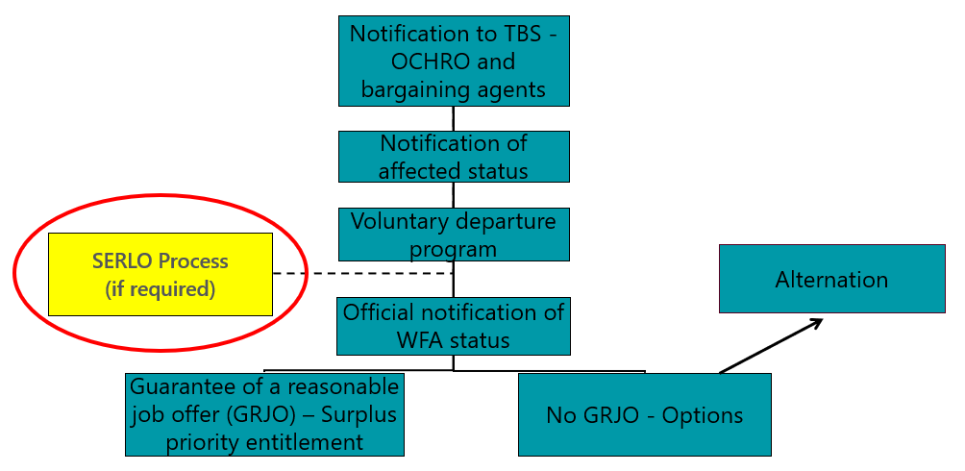
Where does SERLO fit in the WFA process?
Flowchart
Flowchart - long description

Slide 5
Selection of Employees for Retention or Lay‑Off
When does it happen:
  In accordance with subsection 64(2) of the Public Service Employment Act (PSEA), where some but not all employees in any part of the organization will be laid off, the SERLO occurs, in accordance with the Public Service Employment Regulations (PSER).
Who is included:
  Indeterminate employees in the affected work unit
  Employees in the same occupational group and level

Slide 6
Not Included in SERLO
The following individuals would not be included in a SERLO pursuant to subsection 64(2) of the PSEA:
Employees who occupy a unique or stand-alone position, or a position at a different group and level;
Employees appointed for a specified term;
Employees who have accepted an offer of employment or have confirmed, in writing, that they will retire or resign on a specific date;
Executives on special deployments; and
Temporary resources.

Slide 7
Before proceeding with a SERLO
Determine the desired current and future state of the organization
Determine the affected part(s) of the organization
Identify the positions and affected employees
Notify the Treasury Board of Canada Secretariat – Office of the Chief Human Resources Officer (OCHRO), bargaining agents, and employees
Conduct classification and staffing activities
Establish a voluntary departure program

Slide 8
Conducting a SERLO
Determine the qualifications, requirements, and needs
Determine the assessment methods
Identification of biases and barriers
Inform employees
Assessment of employees
Selection of employees
Provide written notice
Record the reasons for the selection
Remember that a SERLO is not an appointment process

Slide 9
Step 7: Determine the qualifications, requirements, and needs
Objective:
A SERLO is to identify which employees will be retained and which will be selected for lay-off. Delegated managers, with the assistance of their human resources specialist, must establish the most relevant qualifications (essential and asset), requirements, and needs for the work to be performed pursuant to subsection 22(2) of the PSER.
Essential qualifications:
Official language proficiency must be established as an essential qualification.
To be selected for retention, employees must meet each essential qualification determined by delegated managers to be the most relevant for the work to be performed.
Asset qualifications, organizational needs, and operational requirements:
Other relevant qualifications, requirements and needs may be established.
Organizational need related to employment equity may be established to address current or anticipated gaps in representation for the four designated groups: women, Aboriginal peoples (now referred to as Indigenous Peoples), persons with disabilities, members of visible minorities.
Any relevant current or future operational needs of the organization.

Slide 10
Steps 8 & 9: Determine the assessment methods and identification of biases and barriers
Objective:
As provided for in subsection 22(4) of the PSER, delegated managers may use any assessment method that they consider appropriate. Subsection 22(6) of the PSER requires that any assessment of an employee’s proficiency in their second official language must be conducted using the same methods as those for appointments to or from within the public service.
Examples of assessment methods:
Official language proficiency: verify second language evaluation (SLE) test results.
Technical Skills: review work samples or prior assessments.
Soft Skills (e.g., interpersonal skills): use structured reference checks and observed behaviors.
Biases and barriers:
In accordance with subsection 22(5) of the PSER, before using their selected assessment methods, delegated managers are required to evaluate them and the manner in which they will be applied. An evaluation serves to identify and remove biases or barriers that disadvantage persons belonging to any equity-seeking group, or to mitigate their impact on those persons.

Slide 11
Step 10: Inform employees
Objective:
Pursuant to subsection 22(3) of the PSER, delegated managers must inform each group of employees participating in the SERLO, in writing, of the qualifications, requirements, and needs; the assessment methods that were chosen; and the fact that employees can request accommodation measures and the process for doing so.
Information to be provided in writing to employees:
Qualifications, requirements and needs for which the employees will be assessed.
Assessment methods that will be used.
Opportunity and process to request accommodation measures.
Additional information delegated manager may wish to communicate to increase transparency:
Qualification definitions.
Factors that will be used to select the employees to be retained.
Overall process and timing of the assessments.
Support and services available to employees who are affected by WFA.

Slide 12

Scenario 1

Slide 13
Step 11: Assessment of employees
Objective:
The assessment process is to determine which employees meet the most relevant essential qualifications, any asset qualifications, requirements, and needs to perform the continuing functions of their positions. Delegated managers must ensure that the employees selected for retention meet the established rating or pass marks established.
Pursuant to subsection 22(7) of the PSER, delegated managers must ensure that employees are assessed in the official language of their choice – English, French, or both – when assessing qualifications, requirements, and needs.
Assessment of official languages:
When assessing knowledge and the use of English, French or both, or a third language, the assessment must be conducted in that language.
SLE results are deemed to be valid for an indefinite period while the employee remains in their substantive position, and the linguistic profile has not been raised above the employee’s skill level.
If the employee’s most recent SLE test results do not meet the official language proficiency requirements of their substantive position, they must undertake another SLE test to demonstrate they meet the requirements.

Slide 14
Step 12: Selection of employees
Objective:
Selection is a crucial step in the process. Pursuant to subsection 22(8) of the PSER, delegated managers must consider how the qualifications, requirements, and needs will factor into their selection for retention.
Requirements of delegated managers for the selection of employees:
At a minimum, all retained employees must meet the essential qualifications, including the official language proficiency established for the SERLO.
Retained employees may need to meet the asset qualifications, organizational needs, operational requirements established for the SERLO.
The selection of employees can only be made based on the factors established for the SERLO.
Records must be kept of reasons for the selection of all employees for retention or lay-off in the SERLO.
Considerations for delegated managers:
Decisions can be made based on the strength of employees in one or multiple elements.
Selection factors may be the same for all the positions to be retained in the SERLO, or they may differ.

Slide 15
Step 13: Provide written notice
Objective:
Pursuant to subsection 21(1) of the PSER, prior to laying off an employee under subsection 64(2) of the PSEA, delegated managers must provide the following, in writing:
Required information in the written notice:
a statement indicating that the employee is to be laid off;
the reason they are selected for lay-off;
their right to make a complaint under subsection 65(1) of the PSEA;
the date on which their services will no longer be required; and
the date on which they are to be laid off or, if that date is not known, a statement indicating that they will be advised, in writing, of that date once it is known.
Additional required information:
the organization is providing the employee with a guarantee of a reasonable job offer (GRJO) and that the employee will be in surplus status from that date on; or
the organization is unable to provide a GRJO, the employee is opting and has access to the options of the WFAD or the WFA appendix of the relevant collective agreement.
As required by the PSER subsection 21(2), delegated managers must also notify, in writing, the employees not selected for lay-off that they are to be retained.

Slide 16
Step 14: Record the reasons for the selection
Objective:
Organizations must be able to demonstrate that the requirements of the PSER have been met. Documentation ensures transparency and reinforces the delegated managers’ accountability for decisions.
Requirement:
Pursuant to subsection 22(10) of the PSER, organizations are required to document the reasons for selecting or not selecting each employee for lay-off.
Key Considerations:
Documentation of the decisions taken prior to and during a SERLO will be useful during discussions with employees.
Documentation will be important for any grievances and complaints to the Federal Public Sector Labour Relations and Employment Board (FPSLREB) and may be required for PSC oversight activities.

Slide 17
True or False

Slide 23
Key sections of PSER for Lay-offs (1 of 2)
Section | Reference
Notice | PSER 21 (1)
Employees retained | PSER 21 (2)
Non-application – specified term | PSER 21 (3)
Selection of employees for lay-off | PSER 22 (1)
Determination of qualifications, requirements and needs | PSER 22 (2)
Information | PSER 22 (3)
Assessment methods | PSER 22 (4)
Identification of biases and barriers | PSER 22 (5)
Second language assessment | PSER 22 (6)
Language of examination or interview | PSER 22 (7)

Slide 24
Key sections of PSER for Lay-offs (2 of 2)
Section | Reference
Assessment and selection | PSER 22 (8)
Volunteers | PSER 22 (9)
Recording reasons | PSER 22 (10)
Non-application – specified term | PSER 22 (11)

Slide 25
Key sections of PSEA for Lay-offs
Section | Reference
Laying off of employees | PSEA 64 (1)
Selection of employees | PSEA 64 (2)
Complaint to Board regarding lay-off | PSEA 65 (1)

Slide 26
Legislation and other references
Public Service Employment Act
Employment Equity Act
Privacy Act
Official Languages Act
Public Service Employment Regulations
Public Service Official Languages Appointment Regulations
Public Service Official Languages Exclusion Approval Order
Selection of employees for retention or lay-off: Guide for managers and human resources specialists
Amendments to the Public Service Employment Regulations

Slide 27
Questions?

Slide 28
Annex A - Where does SERLO fit in the WFA process?
Description of flowchart:
The process begins with the notification to TBS-OCHRO and bargaining agent(s). Then the notification of affected status, followed by the voluntary departure programs and if required, the SERLO process would begin here, if required. This is followed by the official notification of WFA status which would either be the guarantee of a reasonable job offer (GRJO) resulting in a surplus priority entitlement or there's no GRJO which would be accompanied with options. For employees who do not receive a GRJO, there is a possibility of alternation.
Return to flowchart

