Slide 1
Storytelling as a Leadership Skill:
How to Build Decision-Ready Briefings
March 11, 2026 John Stroud
(John@AIGuides.co)

Slide 2


Slide 3



Today’s Agenda
1
2
3
Challenges you face
How stories help
Storytelling tips

Slide 4
Today’s Journey
?
✓
Nervous
Confident

Slide 5
Presentation Myths
You have a data problem
Stories “dumb down” briefings
Storytelling is not for serious people

Slide 6
❝
SECTION
Challenge

Slide 7
You are in the persuasion business
Notes:
We all work in a world of limited resources.We can't do everything, right?

Slide 8
Common challenges
1
Pace of government has accelerated
2
Expected to brief senior leaders in less time, with fewer layers of review
3
Traditional extensive briefing notes no longer match the moment

Slide 9
Common Reactions from Senior Leaders:
1
Why am I reading this?
2
What is the “so what” of this deck?
3
What is the “now what” of this deck?

Slide 10


Slide 11
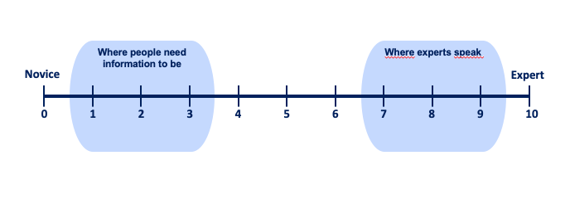
Why Briefing is Hard – the Curse of Knowledge

Slide 12
What to do?
Notes:
If you only take one point from the course make it this: Humans think in stories.I used to be skeptical. Stories were for children.Then I did a course. Danny struggled. Dea asked me to work with him. Get him to begin with a story.He told me about how video games shaped him, and it made him think that Audi could use VR for its training.Week 6 was so different. He was clear and confident. Did a great job.Why do I tell this: since then, when people have to present I ask them to tell me a story about what they're thinking about. It really unlocks what's important to them

Slide 13
❝
SECTION
Tell a story…

Slide 14


Slide 15
We use stories to
impose meaning on the data
Notes:
We all work in a world of limited resources.We can't do everything, right?

Slide 16

Notes:
Sky - points of light

Slide 17

Notes:
We give names to the stars. We create characters. Different cultures have different characters.

Slide 18
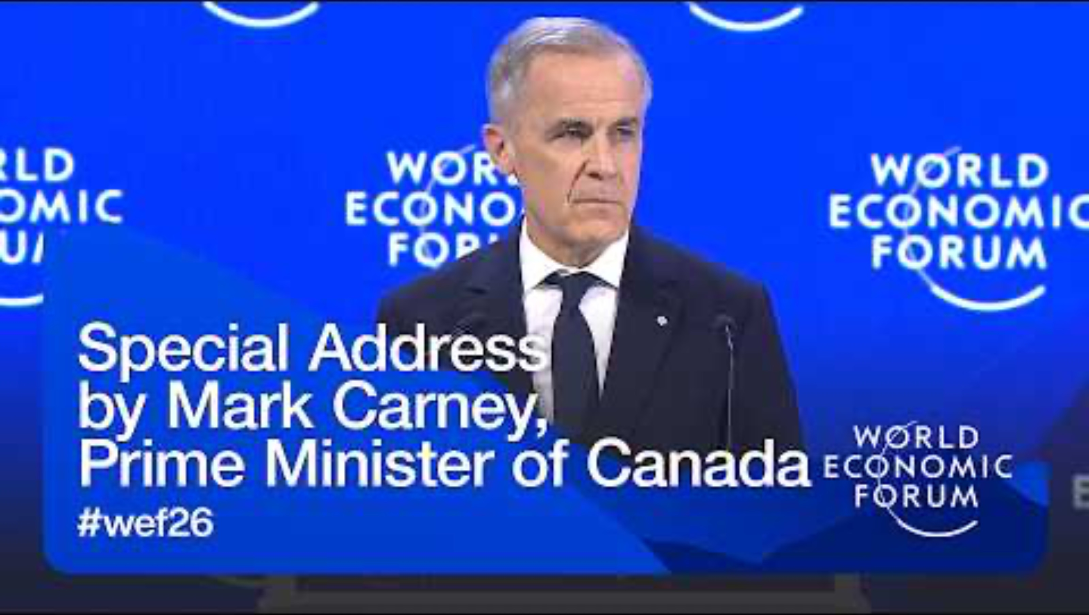

Slide 19
Story components
Hero
Rich Details
Emotion
Focus on a person, not something abstract
A few details to help us imagine that person
Stakes, or a reason to care, about the outcome

Slide 20
Why do stories work?
Notes:
We all work in a world of limited resources.We can't do everything, right?

Slide 21

CARE
BELIEVE

Slide 22


Simple
Complex

Slide 23
Concrete
Abstract

Slide 24
Emotion
Neutral

Slide 25

Simple
Complex
Concrete
Abstract
Emotion
Neutral

Slide 26


CARE
BELIEVE
simple
concrete
emotion

Slide 27
Stories are the language of leaders
Notes:
We all work in a world of limited resources.We can't do everything, right?

Slide 28
SECTION
That overlaps with the interest of your audiences
❝

Slide 29

ABC
Audience Before Content

Slide 30
What is the headline?
EXERCISE
You are a journalist at your high school newspaper. Here are the key facts for your next story.
“The school Principal, Yen Do, announced that the entire school faculty will travel to Toronto next Thursday for a colloquium on new teaching methods in a post-COVID environment. Among the speakers will be author, Margaret Atwood, soccer star, Christine Sinclair, and the Godfather of Artificial Intelligence, Geoffrey Hinton, to speak about motivation, innovation and emergent technology in education.”
What is the headline?
Write your answer here

Slide 31

Use AI to Tailor Your Messages
AI tools like Copilot can help you:
Identify audience pain points
Craft compelling narratives
Simulate your audience’s perspective
Refine your key messages
Notes:
It took me a long time to figure this out.
Course, LInkedIn, Newsletters and Experimentation
Goal: simply it, so you can save all that time.
You Get: Guide: a resource you can refer to when back at your desk.
Uncertainty for Today: how much time to allocate for this.
- If this seems obvious: we can move through it quickly.
If this seems surprising: we’ll take more time.
NOTE: Trying to keep this practical. You’ll get some prompts about “MAGIC WORDS” - ”You’re the Captain of the Starship Enterprise” or appeals to emotion “This is very important to my career.” We’ll keep it simpler.

Slide 32
SECTION
In a structured way
❝

Slide 33
Simple Storyboard
Normal
Complication
New Normal
Once upon a time…
One day…
Until finally…
Because of that…

Slide 34
Example:
Talking like a Bureaucrat
“Boring” Fact/Point:
IT change management requires careful consideration of hidden costs.
.

Slide 35
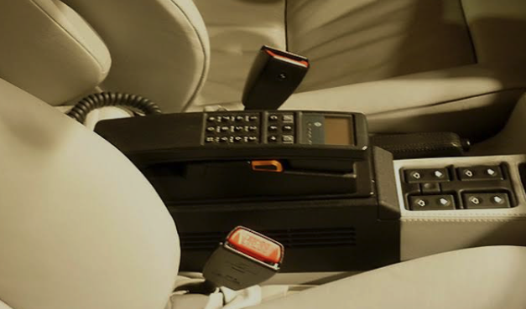
Kevin’s first call on a car phone

Slide 36
Example:
Talking to your smart neighbour
“Boring” Fact:
IT change management requires careful consideration of hidden costs.
.
Kevin the CTO’s first call on a car phone
1) What was the “normal” situation?
”once upon a time…”
Typical teenager in 1980s
2) What is the “complication”
”then one day…”
Dad gets car phone. Calls friend “in secret” when Dad in store.
3) What is the “new normal”
”the moral of the story is…”
Be aware of the “hidden” costs.

Slide 37
How can you use stories to deliver your
main message quickly & effectively?
Notes:
We all work in a world of limited resources.We can't do everything, right?

Slide 38
Option 1: A one-minute story about someone (e.g., Green Grocer)
Two options for a story: 1. Speaking Points • Set the context for what follows 2. Content for a single slide • Way to emphasize a specific point

Slide 39
Option 1: A one-minute story about someone (e.g., Green Grocer)
10 minutes of thoughtful analysis
1 minute story + 9 minutes of thoughtful analysis
VS
Notes:
We all work in a world of limited resources.We can't do everything, right?

Slide 40
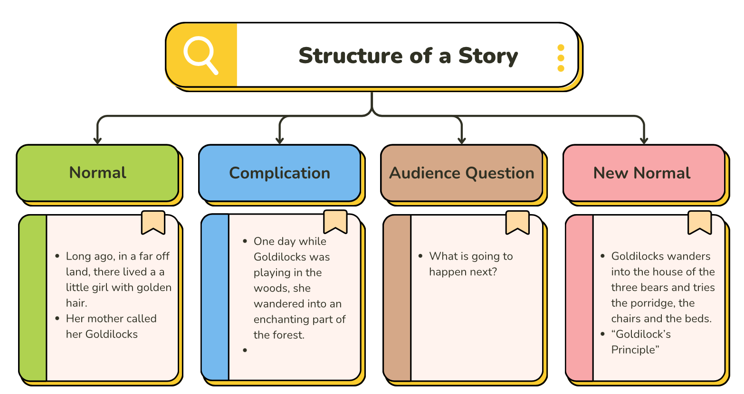
Option 2: Story Framework to set up your Main Message

Slide 41
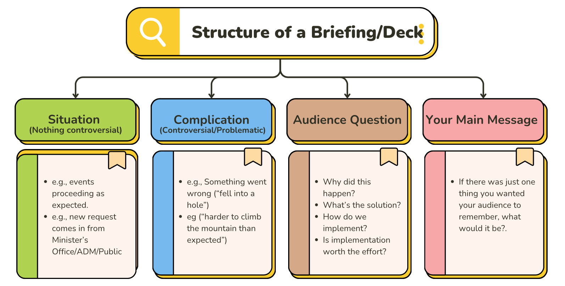
Option 2: Story Framework to set up your Main Message

Slide 42
Option 2: Story Framework to set up your Main Message

Slide 43
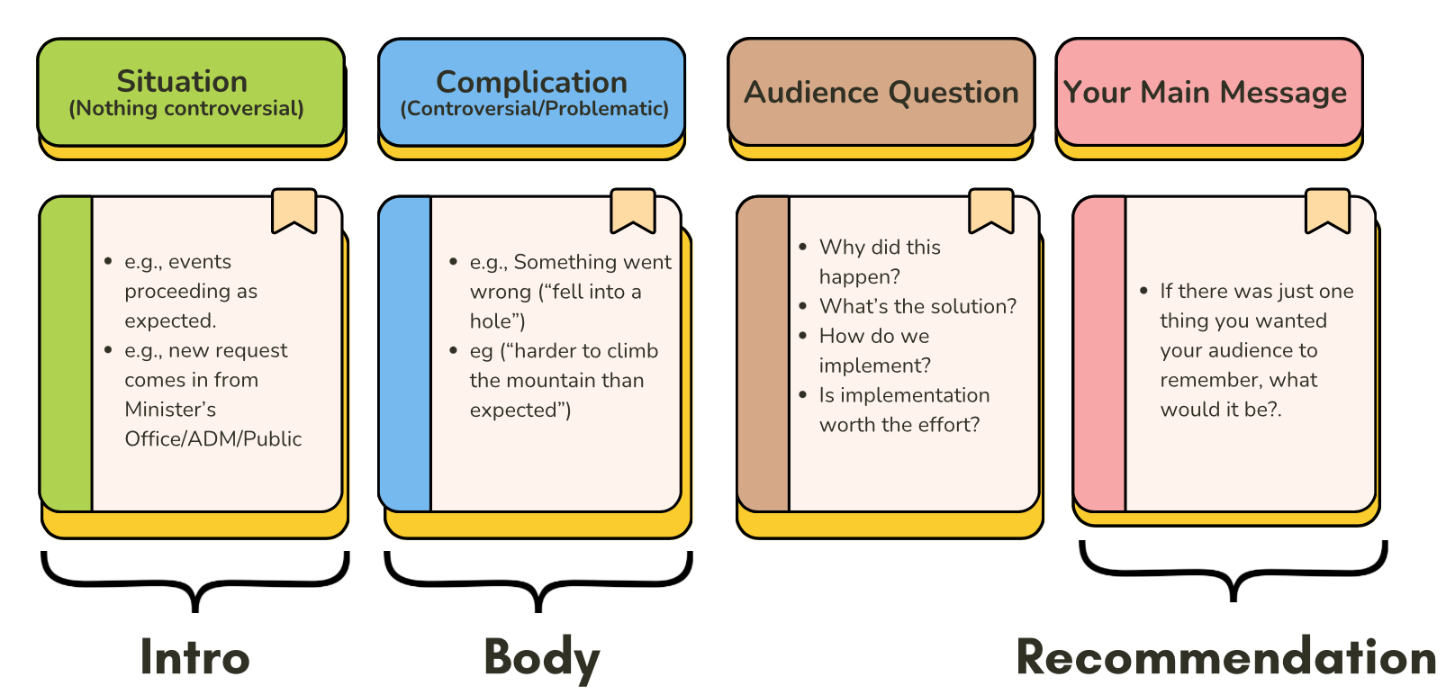
Option 2: Story Framework to set up your Main Message

Slide 44
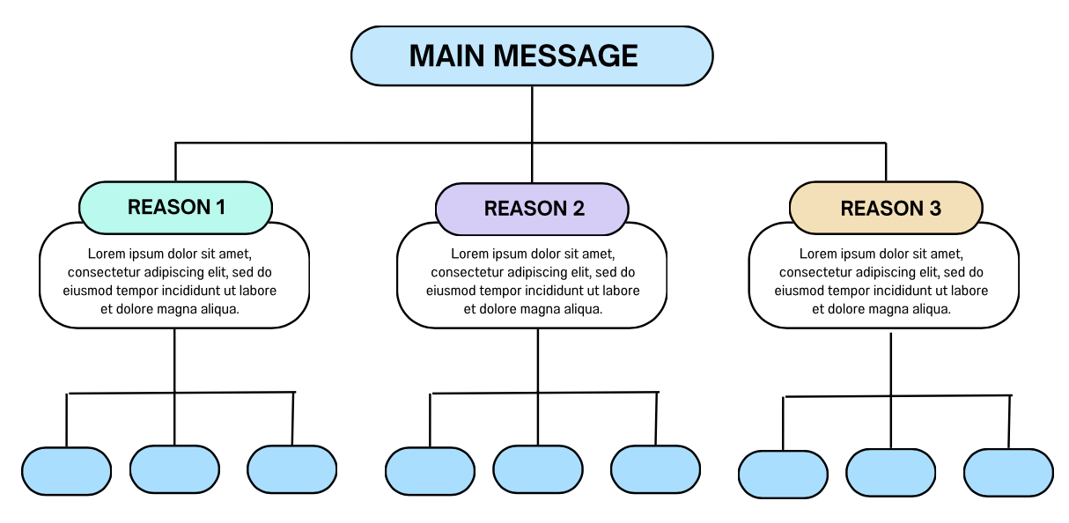
Option 2: Story Framework to set up your Main Message

Slide 45
In summary, if you want to persuade someone:
1
Tell them a story
2
…that overlaps with their interest
3
…in a structured way: normal, complication, new normal
AI can help identify audience pain points and serve as your storytelling coach.

Slide 46
Presentation Myths
Stories “dumb down” issues
Storytelling is not for professionals
You have a data problem
You have a
people problem
Stories respect people’s time
It is how the PM communicates

Slide 48


Slide 49
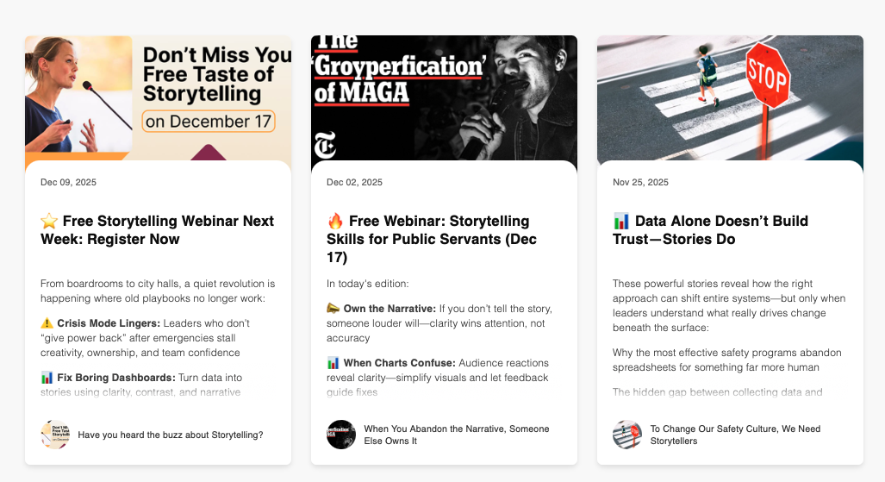

Slide 50
Workshops: Pre-Qualified supplier in Pro-Services and TSPS
Storytelling Workshop
In-Person or Virtual
Half-day or Full Day
AI Workshop Options
In-Person or Virtual
Half-day or Full Day
Benefits
Skills development
Team building

Slide 51

Thank you!
John@AIGuides.co
Jstroud@IOG.ca
Book a follow-up conversation
https://aiguides.co/schedule/

Slide 52
❝
SECTION
Annex:
Presenter Tips

Slide 53
Q: How do I avoid looking “cheesy”
Never say you have a story to tell. Refer to scenarios, case studies, “something that happened last week” etc.
Use the story framework (situation, complication, audience question, main message)

Slide 54
Q: How long should a story be?
Keep it short, especially in the beginning
Aim for 1 minute or less.

Slide 55
Q: Does the story need to be true?
Short answer: yes.
Long answer: omit non-material details, or you’ll get bogged down.

Slide 56
Q: How do I fit a story into my departments template?
Ask AI for help on how to “fit a square peg into a round hole”.
Use the story in your speaking points to frame all the data to follow.

Slide 57
Q: What if I get nervous?
Most people are.
Practice, practice, practice beforehand! Say it out loud!
Even if you go "off script," your ADM doesn’t know.

