Slide 1


Reframing Retirement for the Age of Longevity
May 12th, 2026
Simon Chan, Founder & CEO

Slide 2
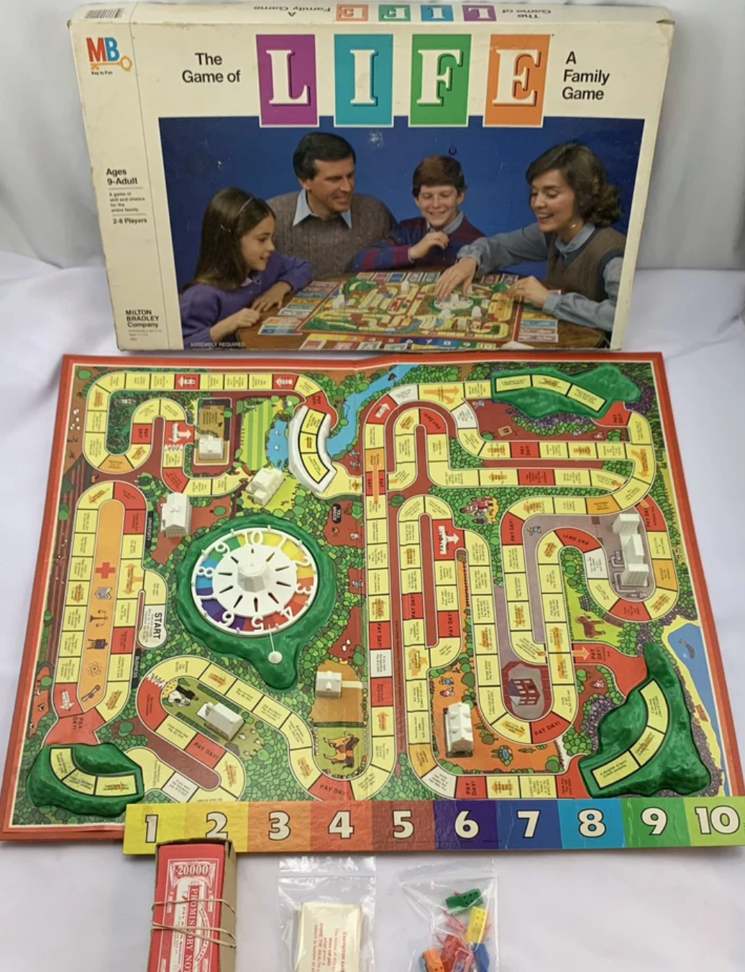
When did you first learn about Retirement?
And does that story still fit your life today?
Milton Bradley - The Game of Life (1978)

Slide 3



A Different Lens on Retirement
1
2
3
Challenge inherited assumptions about aging and retirement
See retirement as a transition, not a finish line
Listen for patterns:
Identity • Purpose • Contribution • Reinvention
Notes:
Today isn’t about telling you how to retire. It’s an invitation to rethink some assumptions.Frame the three listening lenses: aging retirement as a transition portfolio life / purposeful third act

Slide 4




Many forces are reshaping society. One is redefining retirement.
Longer lives are reshaping how we live, work, and retire
AI & Digital Transformation
Globalization & Geopolitics
ESG & Social Responsibility
Longevity & Demographic Change
Notes:
We talk a lot about forces shaping the world- AI, geopolitics, social changeBut there is one force that does something differentIt changes how our lives actually unfold and that is longevityWhen people live longer, what we think of as retirement starts to change

Slide 5
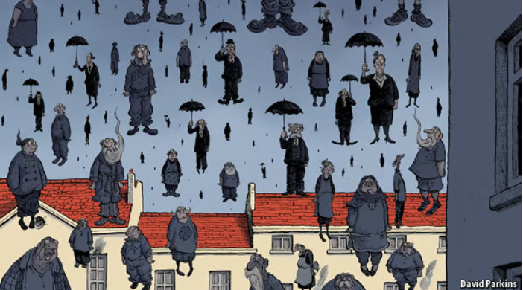
We’ve been taught to see aging as a burden.
What if longer lives unlock new forms of growth, contribution, and purpose?
This is how aging has been framed: a crisis, a burden. But is that the right lens?
The Economist - Age Invaders April 26th, 2014
Notes:
Much of the conversation around aging has been framed through decline, dependency, and burden.But what if this is also one of the greatest design opportunities of our time?

Slide 6

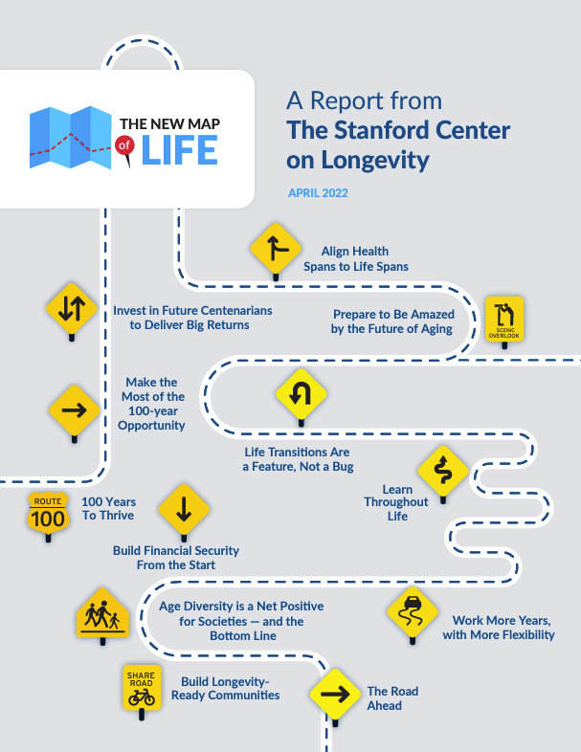




This is a unique and unprecedented opportunity. We have 30 extra years. How could we use those years to improve quality of life at all ages?
Dr. Laura Carstensen, Founding Director

Slide 7
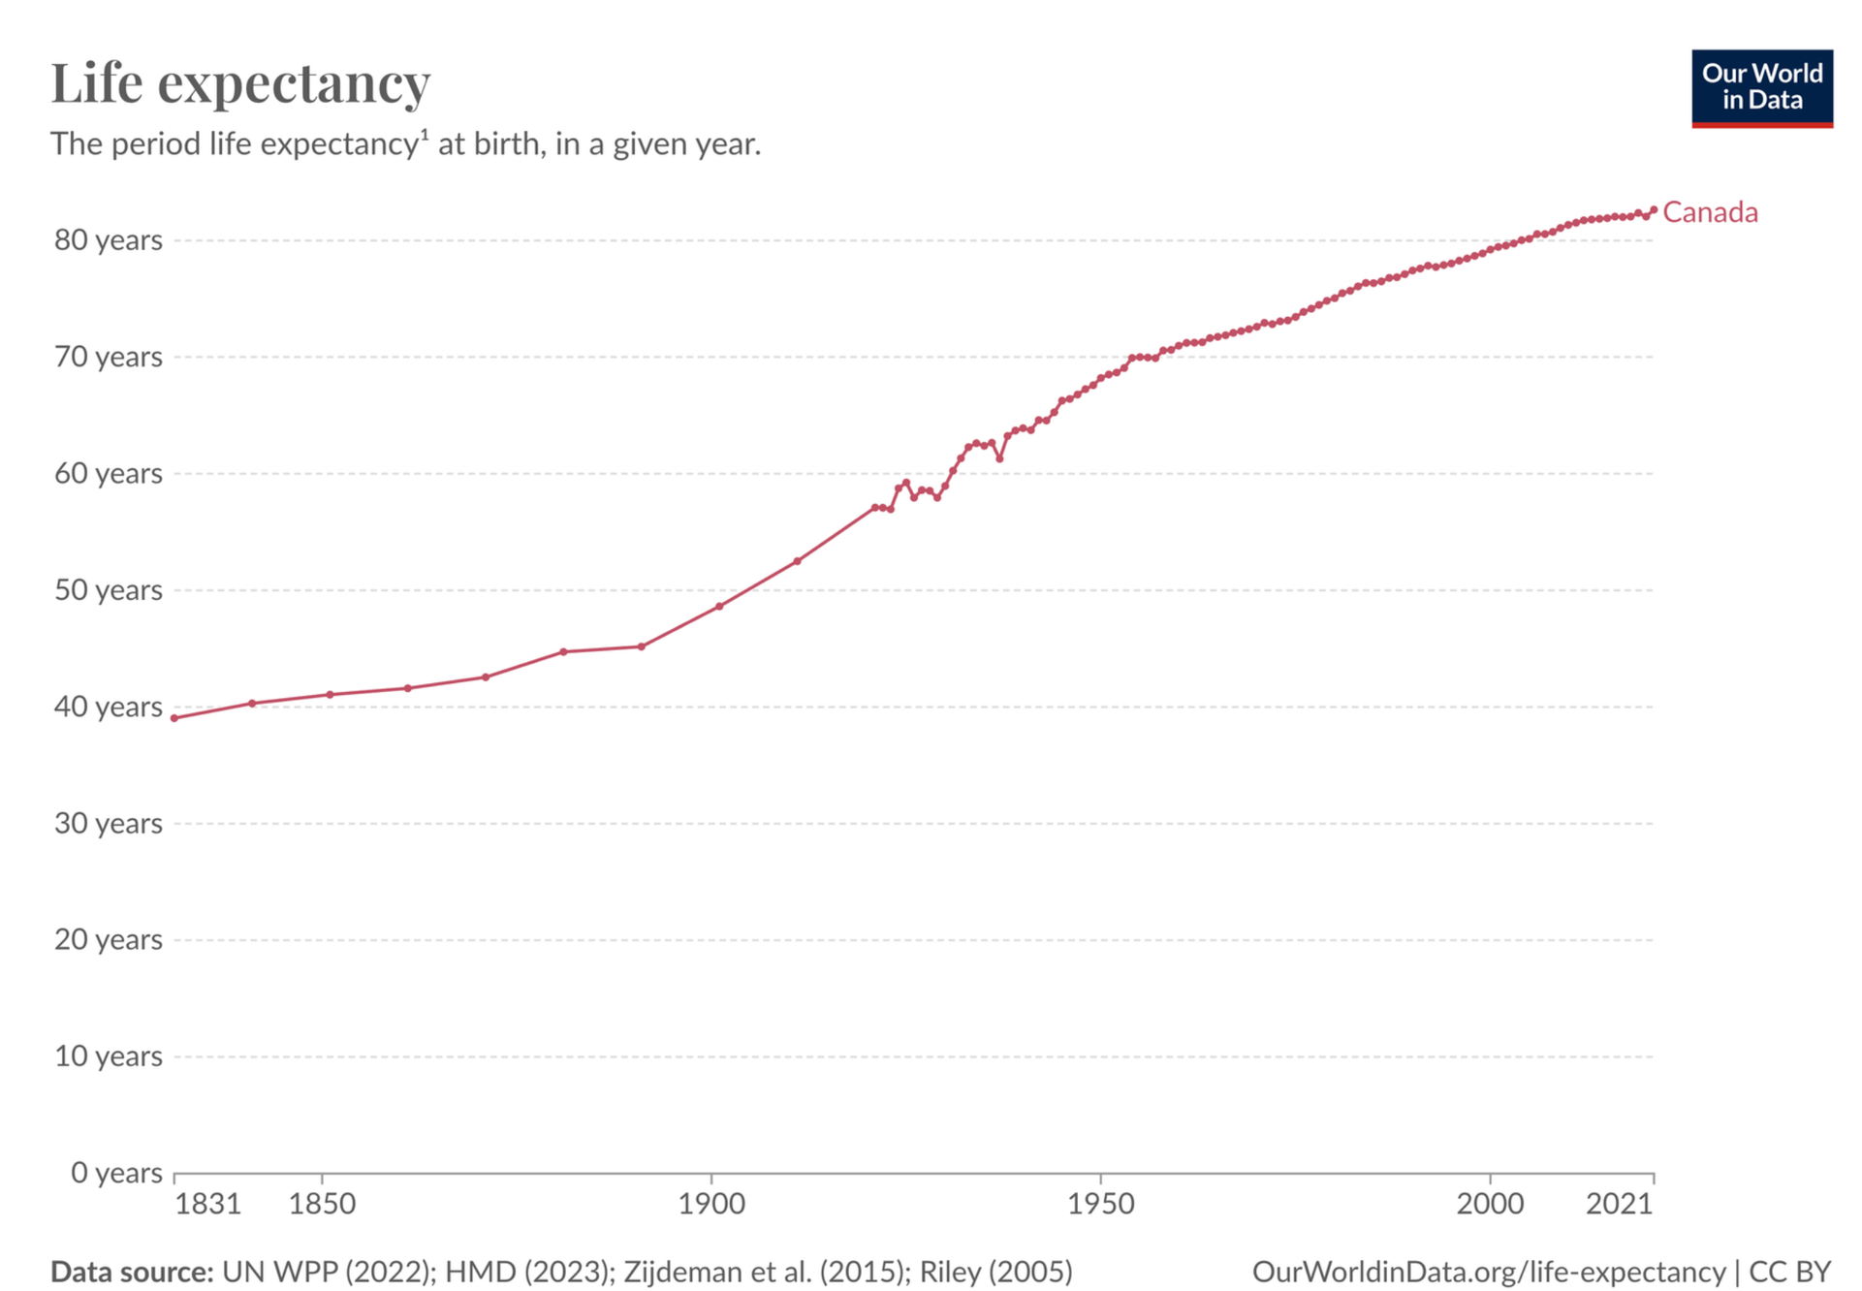
~82.2 year (2024)
We Extended Life.
+30 years of life
~47 years (1900)
Retirement hasn’t evolved with it.
Notes:
Our idea of retirement hasn’t caught up to the reality of longevity.Many retirement systems were built when retirement lasted a handful of years, not multiple decades.

Slide 8



Longer lives are changing the systems around us.
The systems and expectations we rely on were built for shorter lives
For You, as an Individual
For Workplaces & Organizations
For Public Systems
Notes:
Longer lives aren’t just changing retirement for individuals. They’re changing expectations for workplaces, institutions, and society.We upgraded lifespan. But we haven’t fully upgraded the systems around life.

Slide 9
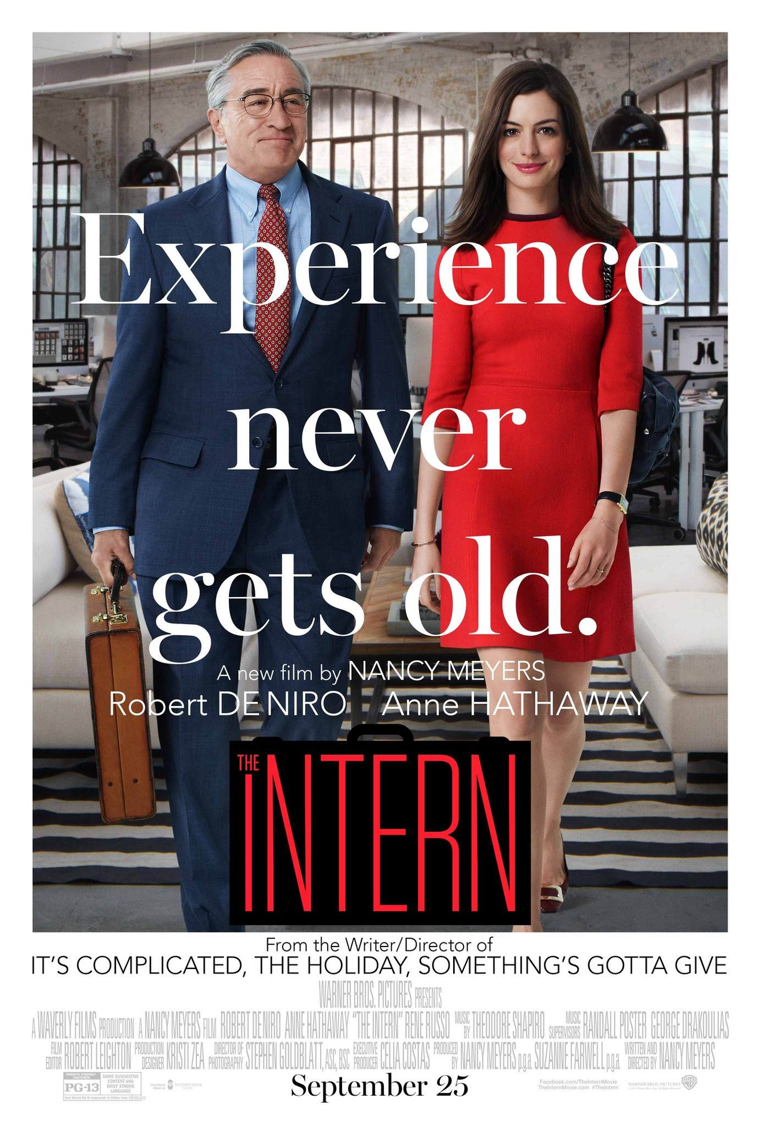





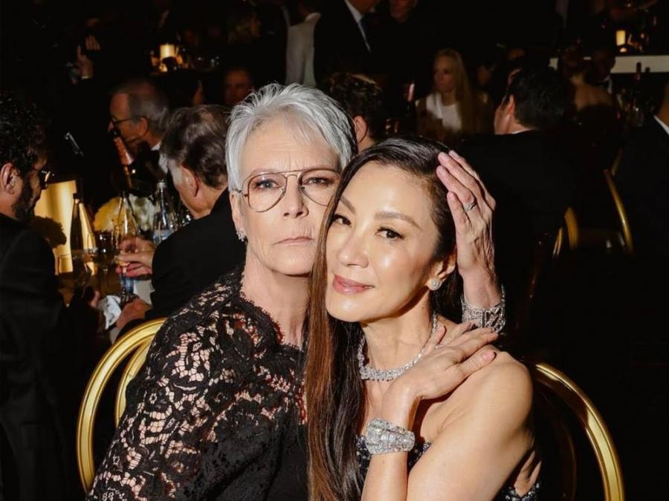
A New Cultural Story Is Emerging
The stories we tell about aging and later life are changing
Notes:
Culture often shifts before institutions do.The picture of later life is becoming more active, engaged, curious, and multi-dimensional.

Slide 10
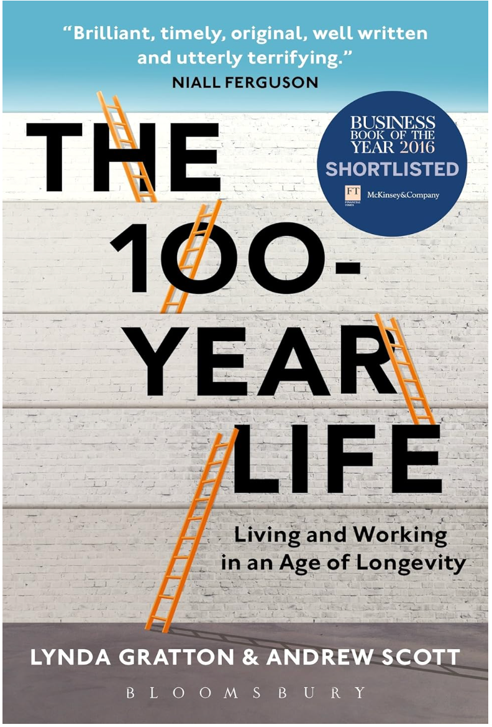
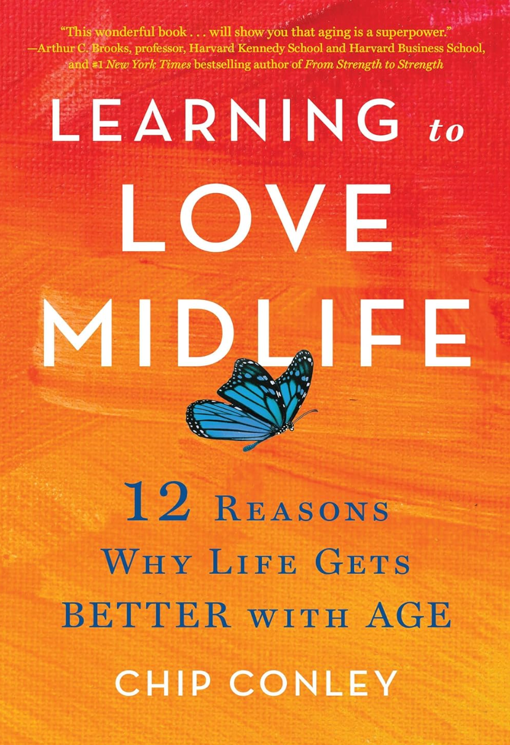
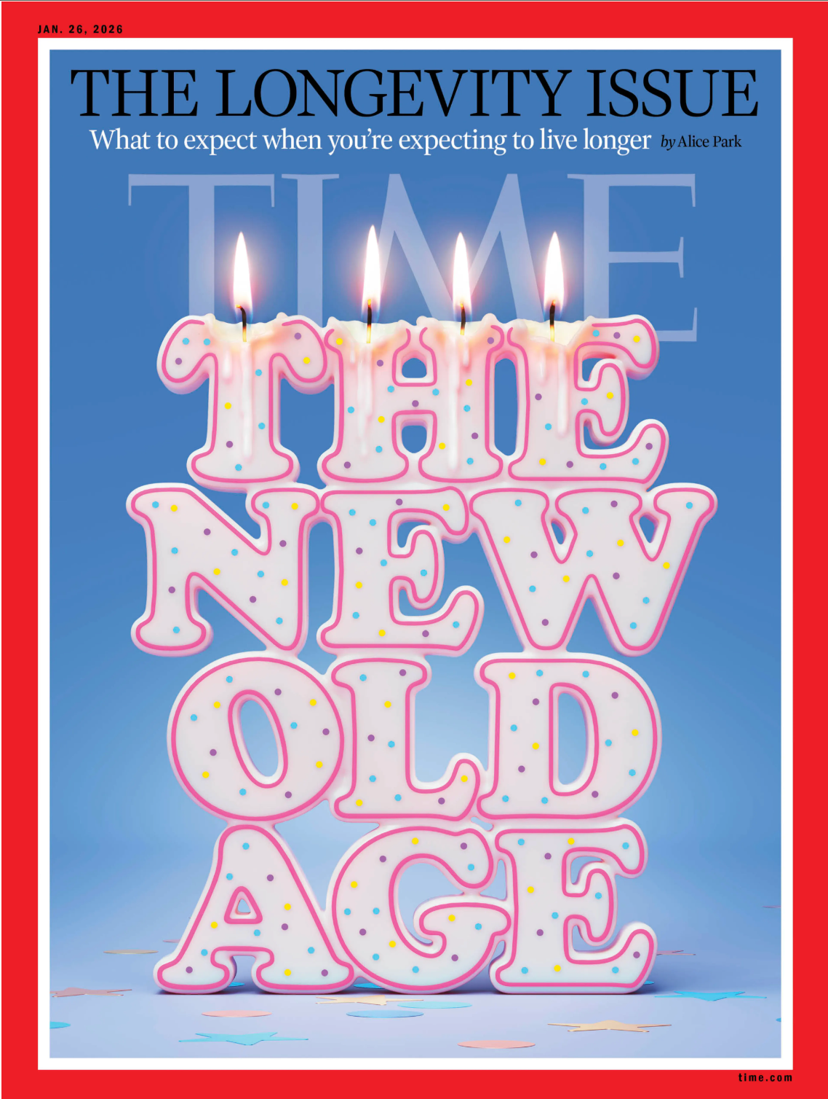




Slide 11
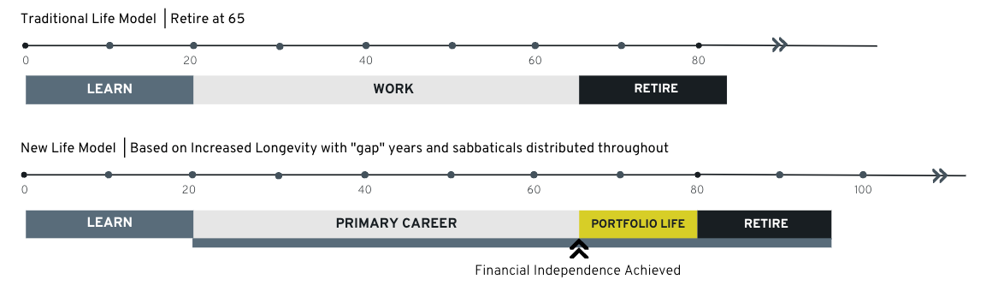
The Three-Stage Life No Longer Fits
Longer lives are creating more transitions and new stages
Longer lives are creating a new life stage between full-time work and traditional retirement
The question shifts from “When do I retire?” to “How do I thrive in this stage of life?”
Most people are navigating this transition without clear role models or pathways

Slide 12
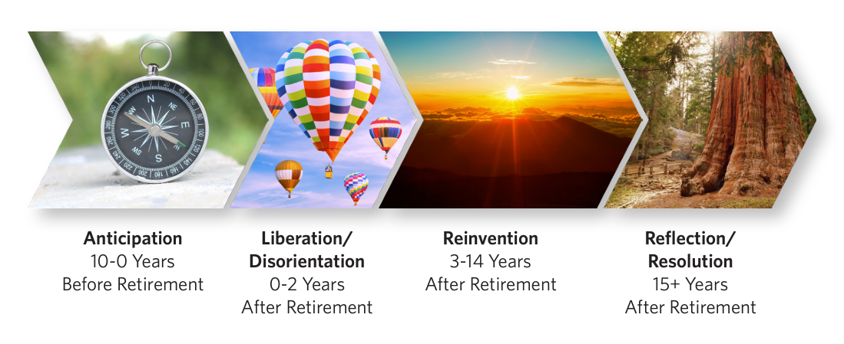
Retirement Is a DIY Transition
Most people are figuring this out as they go
This transition is often longer and more emotional than people expect
Early retirement can feel disorienting before it becomes meaningful
There is no single roadmap. People build this stage over time

Slide 13
1
Retirement is not an ending, It's a 20-30 year life stage
Five Reframes Through a Longevity Lens
2
Financial Readiness is Not Life Readiness
3
Unstructured time can lead to drift not freedom
4
Your mindset about aging shapes your experience
How your perspective shifts when you see retirement in the context of longer lives
5
Retirement is not a single decision. It’s a Multi-Stage Transition

Slide 14



How pre-retirees now describe retirement:
Parents' Generation
Today
1. Retirement Expectations Have Shifted
40%
54%
From winding down to starting something new
A time for rest and relaxation
A new chapter with purpose and opportunity
Mindsets have shifted. Systems are still catching up.
Source: Canadian pre-retirees 45+ Edward Jones/Age Wave - Longevity and the new journey of retirement

Slide 15
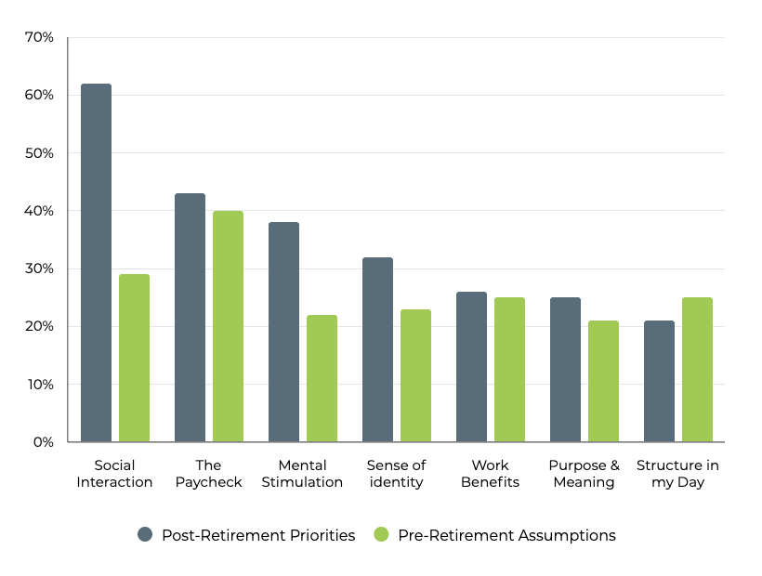
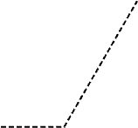
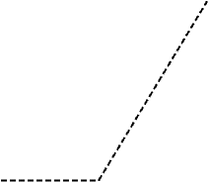
What we plan for is not what drives the experience
2. Financial Readiness is Not Life Readiness
We plan for income. Retirement is shaped by something else.
Source: Retire With Possibilities: Retirement Perspectives and Attitudes Survey 2023

Slide 16
When work ends, more than income disappears.
2,000+ hours per year of structure
3. Freedom Without Structure Can Lead to Drift
Without structure, time can easily drift into passive habits
47 hours per week of TV
Work provides more than income. It provides rhythm, identity, and connection.
Seinfeld (9 Seasons)
Game of Thrones (8 Seasons)
Friends (10 Seasons)
66 hours
74 hours
88 hours
Source: Edward Jones, Age Wave June 2021

Slide 17
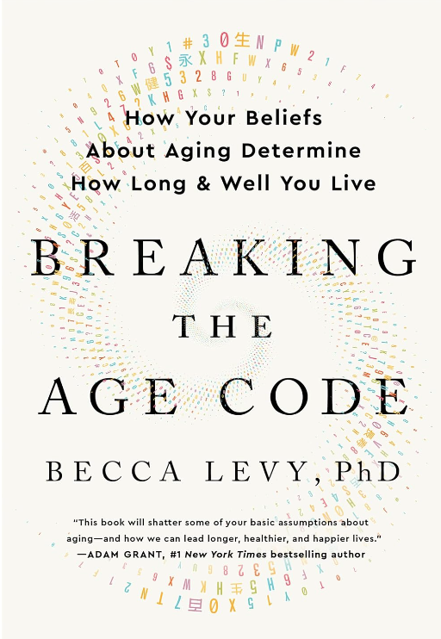
4. Your Mindset About Aging Shapes How You Age
+7.5 years
from positive beliefs about aging
_____________________________________________
70% of Canadians report experiencing ageism
Beliefs shape behaviour. Behaviour drives outcomes
Source: 2025 NIA Ageing in Canada Survey, Yale Public Health

Slide 18
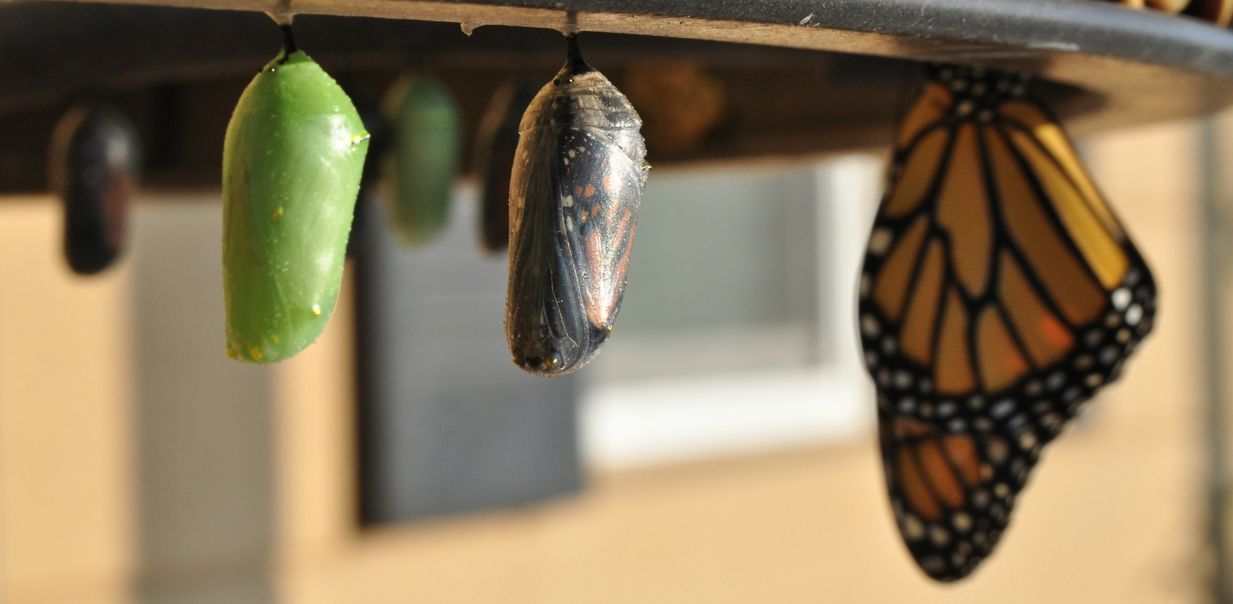
5. Retirement Is Not a Decision. It’s a Multi-Stage Transition
We built pathways for careers. Not for this stage of life.
People know what they're retiring from - but not what they're retiring to
The people who thrive stay curious, adaptive, and connected
This transition is shaped over time through experimentation, reflection, and reinvention
People are beginning to create new models for what this stage can become.

Slide 19




A New Life Stage Is Emerging
Movements like P3A are helping people reimagine purpose, contribution, and growth in this next stage of life.
Many people can tell you what they are retiring from, but they have no idea what they are retiring to
Chip Conley, Founder & CEO, Modern Elder Academy
Notes:
The encouraging part is that people and communities are beginning to build those pathways.Movements like P3A are helping redefine what purpose, contribution, learning, and growth can look like in this next stage of lifeAnd that’s why I’m excited for the conversation ahead today. Because this isn’t theoretical anymore. People are actively designing new models for what this stage of life can become.

